Slide 1

Describing Persons
Module 2
Notes:
(Date of slide or last update given at the top of the notes for each slide)

Slide 2
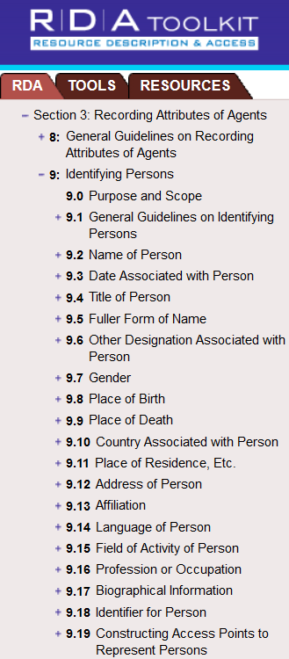
RDA Chapters 8
and 9
Notes:
March 20, 2017
Guidelines and instructions for describing Persons in authority records are found in RDA Chapters 8 and 9.
Agents = a person, family, or corporate body.
At the end of this module, participants will be able to:
- Consult and use RDA and the LC-PCC Policy Statements as reference tools for personal name authorities.
- Apply the rules contained in Chapters 8 and 9 of RDA and related LC-PCC PSs in the creation of personal name authority records.

Slide 3
Scope of “Person”
Definition (RDA 8.1.2)
An individual or an identity established by an individual, either alone or in collaboration with one or more other individuals
→ Persons include persons named in sacred scriptures or apocryphal books, fictitious and legendary persons, and real or fictitious non-human entities (RDA 9.0)
Notes:
February 6, 2019: updated RDA 9.0 language
In RDA, a person can be an individual or an identity established by one individual alone or an identity established in collaboration with one or more other individuals portrayed as being one individual.
The scope statement in RDA 9.0 includes fictitious entities as persons and LC-PCC PS for 9.0 gives the following instruction: “Apply this chapter to fictitious entities and real non-human entities having roles as creators or contributors […]” So under RDA, non-human entities that are presented on a resource as being responsible for the creation of a work will be represented by authorized access points. They are also created in the LC/NACO authority file if needed for any access point, including subject access points.

Slide 4

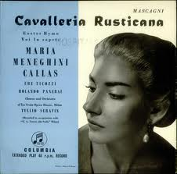


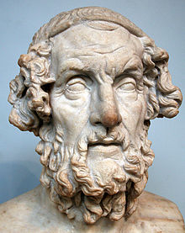



Homer
Homer Simpson
Medusa
Notes:
November 14, 2019: added mythological character image (Medusa)
Even though most of the time you will need to establish names for human entities, let’s look at a couple of examples of other personal names.

Slide 5
Person: Real Non-Human Entity
Authority record
046 $f 1976~ $g 2003-12-12 $2 edtf
100 0_ Keiko, $d approximately 1976-2003
368 $c Killer whale $2 lcsh
373 Marineland (Ont.)
374 Actors $2 lcsh
670 Free Willy, 1993: $b credits (Keiko as Willy)
670 Wikipedia, 3 August 2011 $b (Keiko; born approximately 1976, died December 12, 2003;
male orca actor who starred in the film Free Willy; captured near Iceland in 1979, later sold
to Marineland in Ontario; performed in parks in North America)
Abbreviated bibliographic record
130 0_ Free Willy (Motion picture)
245 10 Free Willy / $c Warner Bros. in association with Le Studio Canal+, Regency Enterprises and Alcor Films.
…
700 0_ Keiko, $d approximately 1976-2003, $e actor.
Module 2. Describing Persons
5
Notes:
January 23, 2023: remove gender
December 12, 2016
Per RDA 9.0, Keiko in the role of Willy, is established in the NAF.

Slide 6
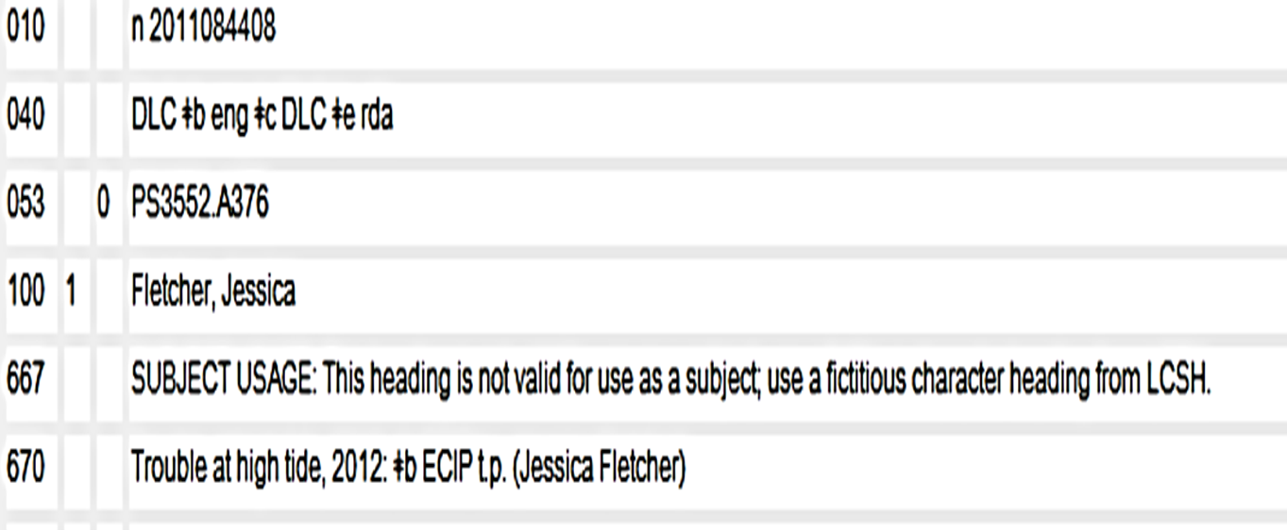
Fictitious Person
NACO RDA/LCSH POLICY UP UNTIL JULY 8, 2013
Module 2. Describing Persons
6
Notes:
Updated February 24, 2014
This RDA NAR has been created for Jessica Fletcher, the fictitious author, whose name appears on a title page as the creator of “Trouble at high tide.”
Note on 040: This NAR was created before many of PCC best practices were developed. The PCC best practice is now to place the subfield $e rda immediately preceding the subfield $c in the 040.
Note on the authorized access point: Note that the qualifier “(Fictitious character)” is not required unless needed to differentiate the name.
Note on the 667 field: LC-PCC PS for 9.0 changed on July 9, 2013. Until July 8, 2013, NACO/LCSH policy was that access points for fictitious characters were only valid as access points for creators and contributors, not also as subject headings. RDA name authority records for fictitious characters created before July 9, 2013 were coded as not valid for use as a subject. Beginning on July 9, 2013 access points for individual fictitious and legendary characters and individual animals with proper names will be established only in the name authority file using RDA instructions. The RDA heading will be valid for use as a subject heading. New LC subject headings for individual characters and individual animals with proper names will not be accepted. Existing LC subject headings may continue to be assigned as subject headings until an RDA name authority record for them is created, at which time the subject authority record must be reported to Policy and Standards Office to be canceled. LC will be undertaking a project to transition all individual character and named animal headings from LCSH to the name authority file. Meanwhile, non-LC catalogers may create records for fictitious and legendary persons and named animal headings in the LC/NACO AF. If they choose to do so and there is a corresponding LCSH, they should request cancellation of the LCSH in favor of the NAR.

Slide 7
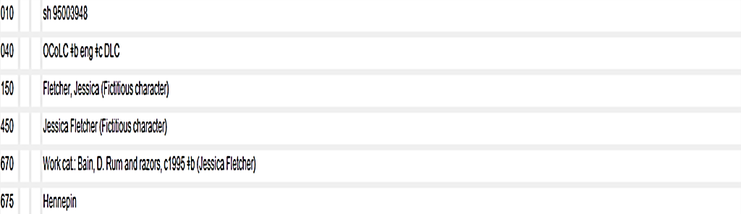
Subject: Fictitious Person
Module 2. Describing Persons
7
Notes:
May 1, 2013
Here is the subject authority record previously created for the fictitious person “Jessica Fletcher” to be used as subject access point.
Separate authority records exist in the Library of Congress/NACO Authority File and the Library of Congress Subject Headings files.
LC-PCC PS for 9.0 changed on July 9, 2013. Until July 8, 2013, NACO/LCSH policy was that access points for fictitious characters were only valid as access points for creators and contributors, not also as subject headings. RDA name authority records for fictitious characters created before July 9, 2013 were coded as not valid for use as a subject.
Beginning on July 9, 2013 access points for individual fictitious and legendary characters and individual animals with proper names will be established only in the name authority file using RDA instructions. The RDA heading will be valid for use as a subject heading. New LC subject headings for individual characters and individual animals with proper names will not be accepted. Existing LC subject headings may however continue to be assigned as subject headings until an RDA name authority record for them is created, at which time the subject authority record will be canceled. LC will be undertaking a project to transition all individual character and named animal headings from LCSH to the name authority file.

Slide 8
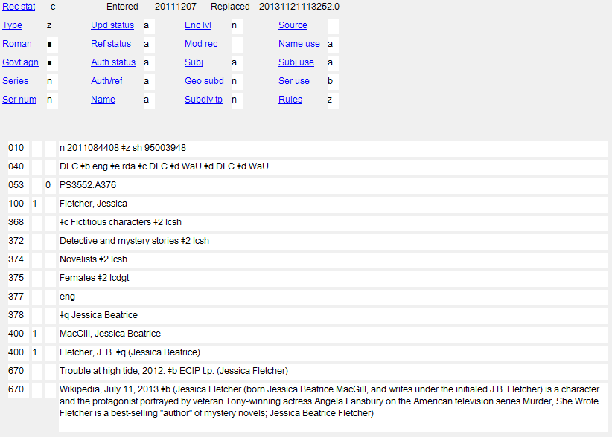
NAR AS REVISED AFTER JULY 9, 2013
Module 2. Describing Persons
8
Notes:
December 12, 2016
As of July 9, 2013, access points for fictitious characters in the name authority file are valid for use as subjects. Note that the 667 that was in the record has been removed and the fixed field 008/11 for Subject heading system/thesaurus code (Subj) and 008/15 for Heading use code—subject added entry (Subj use) are now coded value “a”, meaning this name is now valid for use as a subject.

Slide 9
MARC Coding
Personal names are coded in X00
  ⬧ X00 1_ - a surname in inverted order (surname, forename) or a surname alone
  ⬧ X00 0_ - a forename or a name consisting of words, phrases, initials, separate letters, or numerals in direct order
008/10 (OCLC: Rules) value “z”
  AND
040 subfield $e rda
Notes:
May 1, 2013
RDA records for persons as well as other names are coded “z” in 008/10 (OCLC Fixed Field: Rules).
The “z” indicates “Other” for the source of the descriptive cataloging rules being used and the $e in the 040 field tells us which rules are being used.

Slide 10
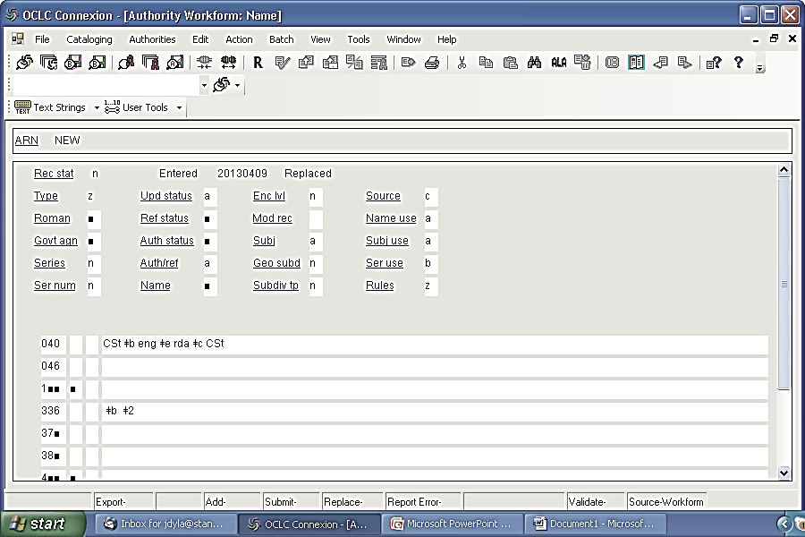
Notes:
Updated February 24, 2014
The PCC best practice is to place the subfield $e rda immediately preceding the subfield $c in the 040.
This slide shows a blank workform in the OCLC Connexion client for creating a single authority record. During this class, you will be using the workform to build up your authority record for a personal name.
PLEASE OPEN A WORKFORM IN OCLC FOR A PERSONAL NAME. We will be adding to it as we go through this module.

Slide 11
Terminology (RDA 8.1.3)
Name:
Word, character, or group of words and/or characters by which a person is known
Preferred Name:
Form to be used when constructing the authorized access point in bibliographic records and 1XX field of name authority records
Variant Name:
Form used in variant access points (4XX fields in name authority records)
Notes:
May 1, 2013
Note that RDA divides names into preferred names and variant names.
Access Points terminology → later slide.

Slide 12
Core Elements for Persons (RDA 0.6.7)
Always record if the information is known
  Preferred name for the person
  Title of the person (a word or phrase indicative of royalty, nobility, ecclesiastical rank or office; a term of address for a person of religious vocation)
  Date of birth
  Date of death
  Other designation associated with the person (for a Christian saint, a spirit, a person named in a sacred scripture or an apocryphal book, a fictitious or legendary person, or a real non-human entity)
  Profession or occupation (for a person whose name consists of a phrase or appellation not conveying the idea of a person)
  Identifier for a person
Notes:
March 20, 2017: updated speaker notes for other designation.
December 12, 2016: updated RDA section number.
August 2, 2019: added parentheticals to 5th and 6th bullets
When recording data identifying a person, include as a minimum these elements if they are applicable and readily ascertainable. Record the elements either as parts of the authorized access point representing the person or as separate elements, or as both.
LCCNs (010) = identifiers.

Slide 13
Core Elements for Persons (RDA 0.6.7)
Record if necessary to distinguish
  Title of person (another term indicative of rank, honour, or office)
  Fuller form of name
  Profession or occupation
  Period of activity of the person
  Other designation associated with person
Notes:
December 12, 2016
March 29, 2018: updated speaker notes
August 2, 2019: added 5th bullet
When recording an element to differentiate one person from another person with the same or a similar name, always add the element to the access point (LC-PCC PS for 0.6.7). However, whether an element is recorded as part of an access point or not, any of these elements may be recorded in special fields in the NAR. As we will see later in this module, the form of the element as recorded in the body of the record may not be the same as the form used in the access point.
[Trainer: see below at slide 57ff for information about the PCC policy on undifferentiated names]

Slide 14
Transcription and Capitalization
RDA 8.5.2. Follow Appendix A.2
RDA 8.5.4. Diacritical marks: record them as they appear; add them if it is certain that they are integral to the name but were omitted in the source
RDA 8.5.5. Retain hyphens if used by the person
RDA 8.5.6. Instructions about spacing between initials
RDA 8.5.7. Abbreviations. Follow the usage of the person
RDA 8.4. Language and script
NACO policy → Romanize vernacular scripts
Notes:
January 19, 2017: corrected RDA number
Note to trainer: go to 8.5.2; have someone read, especially 8.5.6.1. Then go to Appendix A.2 & B.2 and examine together.

Slide 15
Source Consulted (RDA 8.12)
Record in 670 field, or in 046 or 3XX $u/$v
Always include one 670 for the work being cataloged
Others included if needed to justify information in the description
Suggested format:
  670 Title proper, date: $b location (data)
See DCM Z1 670 for best practices and many examples
Notes:
February 28, 2020: revised first bullet to add 046
Core for PCC per LC-PCC PS.
Note to trainer: Everyone go to RDA 8.12: A source consulted is a resource used in determining the name or other identifying attributes of a person, family, or corporate body.

Slide 16
670 field examples
670 Women's economic empowerment, 2007: $b title page (Anjali Kaur)
670 Free Willy, 1993: $b credits (Keiko as Willy)
670 New York times website, viewed January 30, 2018 $b (in obituary dated Jan. 23, 2018: Ursula K. Le Guin died on Monday [January 22, 2018] at her home in Portland, Ore.; author of science fiction and fantasy; in addition to more than 20 novels, she was the author of a dozen books of poetry, more than 100 short stories, seven collections of essays, 13 books for children and five volumes of translation)
670 Péres, Louis. Mikhail Baryshnikov, 1975.
670 OCLC, January 23, 2019 $b (access points: Arnot, Frederick Latham; Arnot, Frederick Latham, 1904-1940; Arnot, F. L. (Frederick Latham), 1904-1940; usage: F.L. Arnot)
Notes:
August 2, 2019: rearranged 670s, revised last three examples, added more explanation in speaker notes.
There are lots of ways to form these. The point is to record information justifying what you’ve included in other elements in the description. For best practices see the DCM Z1 670.
Note: There is no need for a subfield $b in the 4th example, because the entity being described appears in the title.
On OCLC citations: Generally, when citing records found in the OCLC database, record access points found in AACR2 and RDA records as well as usage found in the records. Usage means the forms of name as they appeared on resources in statements of responsibility or other elements that represent transcribed information. Access points are useful because they often include information about associated dates and fuller forms of name. However, always base the preferred name on usage found, not access points.

Slide 17
670 field examples
For online sources, can use $u in 670 field to link to cited resource if it contains significant information that cannot be cited succinctly in the NAR
However, must cite relevant data in $a and $b of a 670 needed to support the 1XX or 4XXs
Information found in online sources may be added to the 046 or 3XX fields with the appropriate citations in subfields $v and $u and not repeated in a 670 when that information is not used in the 1XX or a 4XX. Only $v is necessary; $v should precede $u.
370 Brooklyn (New York, N.Y.) $c United States $2 naf $v
Martindale Hubbell website, December 7, 2012 $u
https://www.martindale.com/attorney/david-aker-157357600/
Notes:
February 28, 2020: new slide to show examples with $u
DCM Z1 670:
Catalogers may optionally provide a uniform resource identifier (URI) in subfield $u of the 670 citation to link to the cited resource if it contains significant information related to the established entity that cannot be cited succinctly in the authority record. Note that use of a URI in the 670 $u does not take the place of the requirement to cite relevant data in subfields $a and $b of the 670 field needed to support the authorized access point (including additions) or variants (this information will continue to be available if the site changes or disappears). However, information found in online sources may be added to the 046 or 3XX fields with the appropriate citations in subfields $v and $u and not repeated in a 670 when that information is not used in the 1XX or a 4XX. If a URI is included in a 670, it must be given in subfield $u.

Slide 18
670 field examples with $u
670 American national biography online, May 14, 2018 $b (Atherton, Gertrude
Franklin (30 October 1857-14 June 1948); author, biographer, and historian;
born Gertrude Franklin Horn in San Francisco, California; in 1887, she left
California to live in New York and travel in England and France; moved to
England in 1895; in 1932 returned to San Francisco; also wrote under the
names Asmodeus and Frank Lin) $u https://doi.org/10.1093/anb/
9780198606697.article.1600050
670 The Canadian encyclopedia, via WWW, April 28, 2015 $b (Frank Davey;
Frankland Wilmot Davey, critic, essayist, poet (born at Vancouver 19 April
1940); raised in Abbottsford; from 1990 to 2005 was a member of the English
department at the University of Western Ontario; authority on contemporary
Canadian literature and culture) $u https://www.thecanadianencyclopedia.ca/
en/article/frank-davey
Notes:
February 28, 2020: new slide to show examples with $u
DCM Z1 670:
Catalogers may optionally provide a uniform resource identifier (URI) in subfield $u of the 670 citation to link to the cited resource if it contains significant information related to the established entity that cannot be cited succinctly in the authority record. Note that use of a URI in the 670 $u does not take the place of the requirement to cite relevant data in subfields $a and $b of the 670 field needed to support the authorized access point (including additions) or variants (this information will continue to be available if the site changes or disappears). However, information found in online sources may be added to the 046 or 3XX fields with the appropriate citations in subfields $v and $u and not repeated in a 670 when that information is not used in the 1XX or a 4XX. If a URI is included in a 670, it must be given in subfield $u.

Slide 19
Preferred Name: Sources of Information (9.2.2.2)
In this priority order
  ⬧ Preferred sources of information (RDA 2.2.2) in manifestations associated with the person
  ⬧ Other formal statements appearing in manifestations associated with the person
  ⬧ Other sources (including reference sources)
Notes:
September 17, 2018: added RDA instruction number for chapter 9
The preferred name for the person is the name or form of name chosen as the basis for the authorized access point representing that person. It should be determined from the sources listed in this slide (in order of preference). Please note that this instruction applies to both: persons that have responsibility as well as persons that are subjects. (The item in hand may be considered a reference source.)
Note to trainer: Have a look at RDA 2.2.2 to see what the preferred sources of information are:
Use as the preferred source of information a source forming part of the manifestation itself that is appropriate to:
- the type of description and
- the format of the manifestation
Other sources mean any other sources besides the manifestation associated with the person.

Slide 20
Preferred Name: Examples
100 1_ Carter, Jimmy, $d 1924-
100 1_ Fein, David $q (David Jonathan)
100 0_ Cher, $d 1946-
100 1_ Smith, Joseph, $c Jr., $d 1805-1844
100 1_ Brown, Hiram S., $c Jr. $q (Hiram Staunton), $d 1909-1979
100 0_ Joan, $c of Arc, Saint, $d 1412-1431 $c (Spirit)
100 0_ Elizabeth $b II, $c Queen of Great Britain, $d 1926-
100 1_ Baryshnikov, Mikhail, $d 1948-
100 1_ Callas, Maria, $d 1923-1977
100 1_ Fraser, Caroline $c (Photographer)
100 1_ Jenner, Caitlyn, $d 1949-
Notes:
March 1, 2019: added Jenner example
August 2, 2019: replaced Elvis Presley spirit example with Joan of Arc example (because it didn’t match with Presley variant example on slide 38, which wasn’t for a spirit)
Only the bolded words are the preferred name. All other pieces of this field are other elements that are additions to the preferred name.
Note the order of elements in the Brown, Hiram S. example.
In the last example, “$c (Photographer)” added to differentiate.
Variant names will be shown on later slides (at the time variant names are discussed: slide 38).

Slide 21

Choosing the Preferred Name for Persons
Duke of Wellington [not Arthur Wellesley]
In 1814 Wellesley was granted the title, Duke of Wellington
The preferred name should be the most-commonly-known form of the name (RDA 9.2.2):
⬧ real name
⬧ pseudonym
⬧ title of nobility
⬧ nickname
⬧ initials
⬧ other appellation
Notes:
March 20, 2017: updated speaker notes to reflect current RDA language
Note to trainer: Read RDA 9.2.2.3 together, then 9.2.2.2.
If the preferred name includes a surname, words indicating relationships can be part of the preferred name if such a word, etc., is part of the commonly-known form, e.g., Jr. (9.2.2.9.5).
If there are variant spellings of the person’s name, use the form found on the first manifestation received or the most commonly found form.

Slide 22
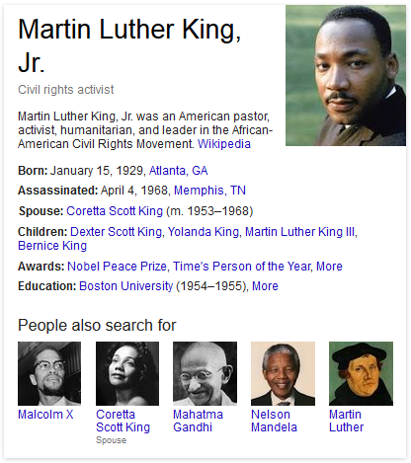
Choosing the Preferred Name for Persons
Words indicating relationship (Jr., III, etc.) are considered part of the preferred name in RDA if commonly found with the name (9.2.2.9.5)
Preferred name:
King, Martin Luther, Jr.
Notes:
February 24, 2014
If the preferred name includes a surname, words indicating relationships can be part of the preferred name if such a word, etc., is part of the commonly-known form, e.g., Jr. (9.2.2.9.5).
Image from google search results for Martin Luther King, 24 Feb. 2014.

Slide 23


Preferred Name: Exercise 1
1957
2003
Notes:
Updated November 15, 2019: added dates of publication to slide
Piedra de Sol, a poem by Octavio Paz (1957)
Espiral de Luz, a book by Dante Salgato published in 2003.
EXERCISE:
Given the evidence here, record in your OCLC workform the preferred name for the author of Piedra de Sol. Note, either one is a “manifestation associated with the person.”

Slide 24
Recording the Preferred Name
(RDA 9.2.2.4)
If the name consists of several parts, record as the first element that part of the name under which the person would normally be listed in authoritative alphabetic lists in his or her language or country of residence or activity, followed by other parts of the name.
Exception
If a person's preference is known to be different from the normal usage, follow that preference in selecting the part of the name to be recorded as the first element.
Notes:
May 1, 2013
For names in several specific languages such as Malay, Romanian, and so on, you should consult additional instructions in Appendix F.
This general guideline is followed by more specific instructions for recording names:
- containing a surname
- containing title of nobility
- containing neither a surname nor a title of nobility
- consisting of initials, or separate letters, or numerals

Slide 25
Different Forms of the Same Name (RDA 9.2.2.5)
Fullness (RDA 9.2.2.5.1)
  Choose the most commonly found form as the preferred name
  If no predominant form, choose the latest form as the preferred name
  In case of doubt about which is latest form, choose the fuller or fullest form
  Record the other forms as variant names - optional (MARC field 400)
Notes:
November 14, 2019: added third bullet and examples in speaker notes
Fullness (9.2.2.5.1)
If the forms of a person’s name vary in fullness, choose the form most commonly found as the preferred name. If no one form predominates, choose the latest form as a preferred name. In case of doubt about which is the latest form, choose the fuller or fullest form. Record the other forms of the name as variant names (see 9.2.3.10).
Examples:
Two forms of the same name: Morris West; Morris L. West. Morris L. West is a fuller form than Morris West. Since Morris West is the most commonly found form, it gets chosen as the preferred name.
Two forms of the same name: Patricia Boren; Patricia M. Boren. Patricia M. Boren is a fuller form than Patricia Boren. There is no predominant form. Patricia M. Boren is the latest form, so it is chosen as the preferred name.

Slide 26
Different Forms: Language
(RDA 9.2.2.5.2)
Choose the form in the language most commonly found in manifestations associated with the person as the preferred name
Record the other forms as variant names (MARC field 400)
Exceptions
Greek or Latin - choose the form most commonly found in reference sources
Given name - choose the well-established form of name in reference sources in the language preferred by the agency creating the data
Notes:
March 20, 2017: updated to reflect current RDA language
If a person’s name has appeared in different language forms in manifestations associated with the person, choose the form corresponding to the language of most of the manifestations as the preferred name. Record the other forms as variant names.
Greek or Latin
Choose the form most commonly found in reference sources as the preferred name.
Form in the language preferred by the agency creating the data
If there is a well-established form of name in reference sources for a person whose given name, etc., is recorded as the first element in the preferred name (see 9.2.2.18) in the language preferred by the agency creating the data, choose that form of name as the preferred name.

Slide 27
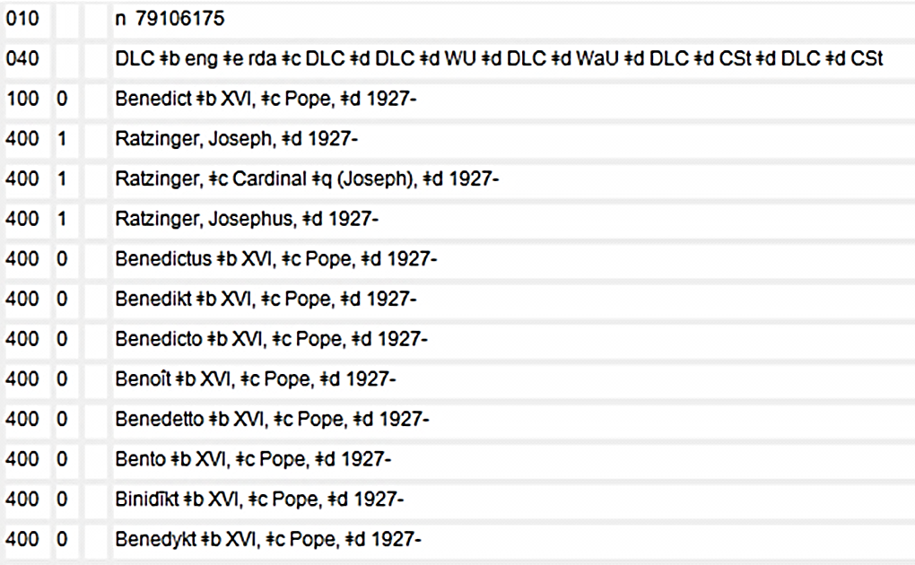
Different Forms: Language
Given Name
Notes:
May 1, 2013

Slide 28
Different Forms: Non-preferred Script (RDA 9.2.2.5.3)
Authorized access points recorded in the Latin script
Follow the ALA-LC Romanization Tables: Transliteration Schemes for Non-Roman Scripts, as needed
Non-Latin script forms may be recorded as variant names (MARC field 400)
Notes:
May 1, 2013; revised speaker notes April 25, 2017 to explicitly indicate 008/29 value “b”
PCC libraries will continue to record names in the Latin script in the authorized access points in authority records and in bibliographic records. When transliteration is necessary, follow the ALA-LC Romanization Tables: Transliteration Schemes for Non-Roman Scripts. PCC libraries may also continue the current policy for these languages/scripts: Perso-Arabic script (e.g., Arabic, Persian, Pushto, Urdu); Hebrew, Yiddish; Chinese, Japanese, Korean; Cyrillic-based scripts; and Greek, to give variant access points in the original language/script in authority records (MARC 4XX fields, Ref status:
008/29=“b”, and 667 note: Non-Latin script reference/s not evaluated).
Note to trainer: If participants interested, go over the LC Practice for Alternative for names in Chinese, Japanese, Korean, Cyrillic and Hebrew alphabet described in LC-PCC PS for 9.2.2.5.3. Korean example added on the next slide can be hidden if not needed (Slide Show → Hide Slide). Examples in other scripts can be added as needed.

Slide 29
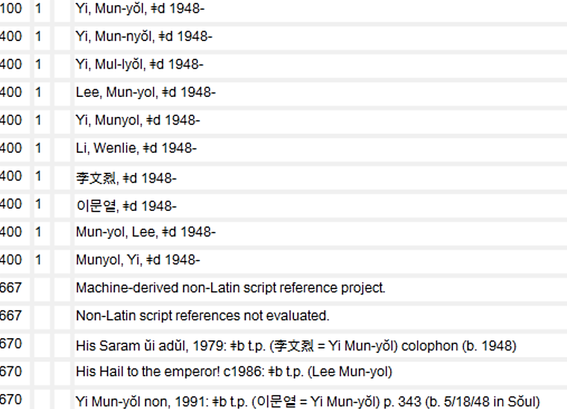
Notes:
May 1, 2013

Slide 30
Change of Name (RDA 9.2.2.7)
Choose the latest name or form of name as the preferred name
Exception
Choose an earlier name if it is better known, e.g.,
  Caroline Kennedy
(better known than her latest name after marriage: Caroline Kennedy Schlossberg)
Notes:
May 1, 2013

Slide 31
More Than One Identity (RDA 9.2.2.8)
Choose the name associated with each identity as the preferred name for that identity
If an individual uses only one pseudonym and does not use his or her real name, choose the pseudonym as the preferred name
  ⬧ Record the real name as a variant (MARC field 400)
When creating NARs for a person with different identities, follow the guidelines in the DCM Z1 663 and 667 and the “FAQ – LC/PCC practice for creating NARs for persons who use pseudonyms”
Notes:
March 20, 2017: updated speaker notes for LC-PCC PS
This means that multiple NARs will be created, each representing one identity.
Consider an individual who uses one or more pseudonyms (including joint pseudonyms), or his or her real name as well as one or more pseudonyms, to have more than one identity.
If an individual uses only one pseudonym and does not use his or her real name as a creator or contributor, choose the pseudonym as the preferred name. Record the individual’s real name as a variant name.
LC-PCC PS for 30.1.1.3
For NARs for a person with different identities, follow the guidelines in the Descriptive Cataloging Manual Z1 sections for MARC fields 663 and 667. More information is available in the FAQ for creating NARs for persons who use pseudonyms: http://www.loc.gov/catdir/cpso/pseud.pdf
NARs for multiple identities and recording relationships between different identities will be covered later.

Slide 32
Compound Surnames (RDA 9.2.2.10)
A compound surname consists of two or more proper names separated by either a space or a hyphen.
  ⬧ First element determined by the established usage or the preference of the person
  If not known, follow IFLA’s Names of Persons service (http://www.ifla.org/node/4953)
    Names of Persons: National Usages for Entry in Catalogues, 4th revised and enlarged edition (München: Saur, 1996)
    Online updates
Notes:
March 20, 2017
Record as a variant name forms of the name using other parts of the compound surname as the first element.
IFLA’s Names of Persons service includes a scanned version of the out of print Names of Persons: National Usages for Entry in Catalogues, 4th revised and enlarged edition (München: Saur, 1996), as well as the latest updates. The scanned version of Names of Persons is also available through Cataloger’s Desktop.

Slide 33
Surnames with separately written prefixes
(RDA 9.2.2.11)
First element determined by the usage of the person’s language
See appendix F for additional guidance
John Van Valkenburg (American)
Van Valkenburg, John
Dirk Van Valkenburg (Dutch)
Valkenburg, Dirk van
Jeroen Van Valkenburg (Afrikaans)
Van Valkenburg, Jeroen
Guy de Maupassant (French)
Maupassant, Guy de
Notes:
February 24, 2014: slide animated
ANIMATED SLIDE
PLEASE FIND APPENDIX F IN RDA.
Appendix F contains ADDITIONAL INSTRUCTIONS ON NAMES OF PERSONS for a number of languages listed in an alphabetical order. Let’s check Appendix F11 for instructions on recording names in different languages that include prefixes.
According to Appendix F, what element would begin the preferred name for each of these persons? [NOTE: Animated slide]
Record as a variant name a form using another part as the first element. The first element of the variant name can be another part of the prefix or the part of the name following the prefix.
Note to trainer: If participants interested in Arabic, Hebrew, Yiddish, or Urdu, point to LC-PCC PS for F.11.

Slide 34
Names Containing a Title of Nobility
General Guidelines RDA 9.2.2.14
Titles in the United Kingdom Peerage That Include a Territorial Designation RDA 9.2.2.15
Judges of the Scottish Court of Session Bearing a Law Title Beginning with Lord RDA 9.2.2.16
Disclaimed and Newly Acquired Titles RDA 9.2.2.17
Notes:
May 1, 2013
This and the next 4 slides list additional, specific guidelines for your reference.

Slide 35
Names Containing Neither a Surname nor a Title of Nobility
General Guidelines 9.2.2.18
Names Including a Patronymic 9.2.2.19
Names of Royal Persons 9.2.2.20
Notes:
May 1, 2013

Slide 36
Names Consisting of Initials, or Separate Letters, or Numerals
General guidelines RDA 9.2.2.21
  ⬧ Record in direct order
  ⬧ Include any typographic devices that appear as part of multi-letter abbreviations, but omit them when they follow single-letter initials
Notes:
May 1, 2013
Examples on the next slide.

Slide 37
100 0_ A. B. C. D. E.
670 Novembris monstrum, or, Rome brovght to bed in England, 1641: $b t.p. (by A.B.C.D.E.)
100 0_ D. S., $c Master, $d active 1505-1511
670 Author's Holzschnitte des Meisters D.S., 1924.
100 0_ DJ Q, $d 1974-
670 All music guide WWW site, June 29, 2005 $b
(DJ Q; real name: Paul Flynn; b. 1974; Glasgow, Scotland)
100 0_ 61648 $c (Writer)
670 North Eastern main line steam, 1981?: $b title page (compiled by “61648”)
Notes:
October 23, 2018: added colon in last 670
Note: Some examples come from AACR2 authority records; “title page”, “born”, etc., in the 670 notes in RDA NARs will most often be spelled out rather than abbreviated as “t.p.” and “b.”.

Slide 38
Names Consisting of a Phrase
General Guidelines RDA 9.2.2.22
Phrase Consisting of a Given Name or Given Names Preceded by a Term of Address, etc. RDA 9.2.2.23
Phrase Containing the Name of Another Person RDA 9.2.2.24
Characterizing Word or Phrase RDA 9.2.2.25
Phrase Naming Another Work by the Person RDA 9.2.2.26
Notes:
November 15, 2019: added examples in notes
March 20, 2017: updated to reflect current RDA language
Characterizing Word or Phrase
Apply the Alternative per LC-PCC PS for 9.2.2.25: Omit an initial article (see appendix C) when recording a characterizing word or phrase.
Military Chaplain
Statement of responsibility: by A Military Chaplain
Phrase Naming Another Work by the Person
Apply the Alternative per LC-PCC PS for 9.2.2.26: Omit an initial article (see appendix C) when recording a phrase naming another work by the person.
Author of Honesty the best policy
Statement of responsibility: by The Author of Honesty the best policy

Slide 39
Variant Name for the Person
(RDA 9.2.3)
Name or form of name not chosen as the preferred name
Found in manifestations associated with the person and/or in reference sources
Record per cataloger judgment
Record following the general guidelines on recording names given in Chapter 8
Record in the 400 field
Notes:
March 20, 2017: updated to reflect current RDA language
Variant name could be
- a real name if the preferred name is a pseudonym (9.2.3.4),
- a secular name if the preferred name is a name used in religion (9.2.3.5) and vice versa (9.2.3.6),
- an earlier name (9.2.3.7) and a later name (9.2.3.8),
- an alternative linguistic form (9.2.3.9), and
- any other name that a cataloger judged useful to be recoded.
RDA does not require any categories of variant access points – catalogers should use their judgment on which variants to include. An earlier name by which the person might have been known could be a good example of a variant that you would want to record.

Slide 40
Variant Name: Examples
400 1_ Carter, James Earl, $c Jr., $d 1924-
400 1_ Bono, Cher, $d 1946-
400 0_ Jeanne, $c d'Arc, Saint, $d 1412-1431 $c (Spirit)
400 1_ Windsor, Elizabeth, $c Queen of Great Britain, $d 1926-
400 1_ Барышников, Михаил, $d 1948-
400 1_ Meneghini Callas, Maria, $d 1923- 1977
400 1_ Jenner, Bruce, $d 1949-
Notes:
August 2, 2019: replaced Presley example with one for a spirit that matches Joan, of Arc example used as replacement in slide 20
March 1, 2019: added Jenner example
Note to trainer: LOOK AT MARC authority format 400 field.
Here are the names from the list we looked at earlier while talking about the preferred names (Slide 18). Only the bolded words are the variant name. All other pieces of the 400 field are other elements.
Note to trainer: comment on each one.

Slide 41
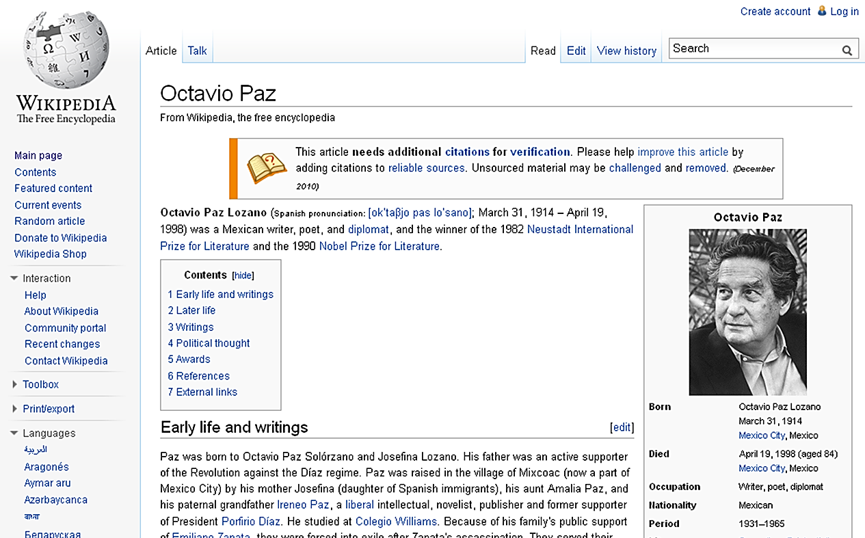
Exercise 2
Notes:
March 1, 2019: corrected typo in speaker notes
EXERCISE 2:
Based on the information in Wikipedia, record the variant name for Octavio Paz on your workform.

Slide 42
Dates Associated with Persons
(RDA 9.3)
As a core element, birth and death dates must be recorded if information available from any source
046 $f - Date of birth
$g - Date of death
Add to the preferred name if available (new NARs or if otherwise changing the 100 field)
Notes:
November 15, 2019: added parenthetical in second bullet
Core. RDA 9.3.1.3: Record dates either as parts of the authorized access point representing the person, or as separate elements, or as both. Record the year alone for birth and death date; add the month or month and day if necessary to distinguish one access point from another.
but
LC-PCC PS for 9.19.1.3 instructs us to follow the RDA 9.19.1.3 Optional Addition and always add a date of birth and/or date of death to access points (even if not needed to distinguish). Use a hyphen after date of birth (do not use the term “born”); use a hyphen before the date of death (do not use the term “died” with the date) (LC-PCC PS for 9.3.2.3 and 9.3.3.3).
The same LC-PCC PS for 9.19.1.3 instructs us not to add a date of birth and/or date of death to an existing authorized access point without dates unless otherwise changing the 100 field.

Slide 43
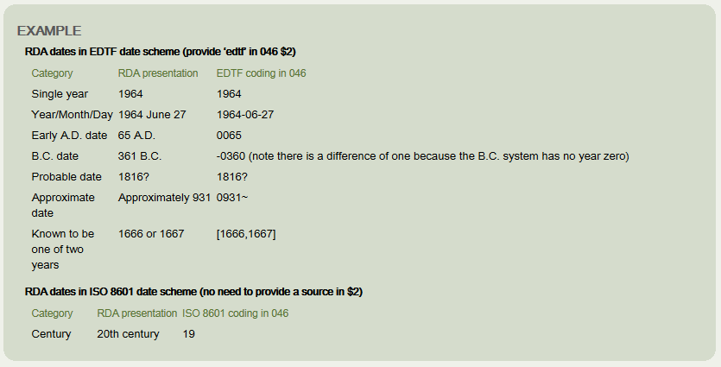
Recording Dates (LC-PCC PS for 9.3.1.3)
Notes:
November 24, 2015
Except for century dates, this element is recorded in MARC 046 in the format YYYY-MM-DD or YYYY-MM or YYYY (using the EDTF format, with $2 edtf).
EDTF format: http://www.loc.gov/standards/datetime/. See this website for more complex situations.
Century dates do not follow the EDTF format. Simply record the first two digits of the century (e.g. “19” = all dates beginning with “19” = 20th century) with no $2.

Slide 44
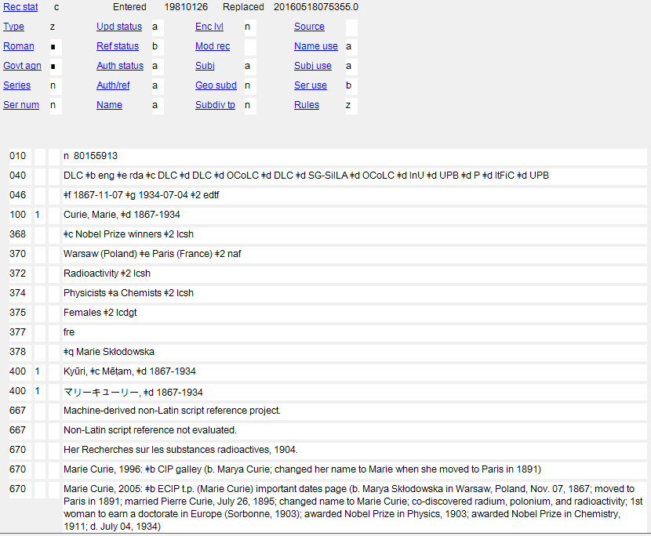
Dates Associated with Persons
Notes:
October 2, 2024: added instructor note about 375 seen in the slide
March 20, 2017: updated red boxes to highlight birth and death dates
Recorded in this NAR (in case it is hard to read from the slide):
670 Marie Curie, 2005: $b ECIP t.p. (Marie Curie) important dates page (b. Marya Skłodowska in Warsaw, Poland, Nov. 07, 1867; moved to Paris in 1891; married Pierre Curie, July 26, 1895; changed name to Marie Curie; co-discovered radium, polonium, and radioactivity; 1st woman to earn a doctorate in Europe (Sorbonne, 1903); awarded Nobel Prize in Physics, 1903; awarded Nobel Prize in Chemistry, 1911; d. July 04, 1934)
Note about 375 in case anyone notices: catalogers will encounter existing authority records in which gender has been recorded in field 375. PCC no longer uses this field and it should be deleted when revising an authority for any other reason.

Slide 45
Dates Associated with Persons
If the person’s date of birth and date of death are both unknown, a date or range of dates indicative of the person’s period of activity is recorded instead (RDA 9.3.4.3)
046 $s - Start period
$t - End period
Use “active” rather than “flourished” in access points
Add to the preferred name only if needed to differentiate otherwise identical names
Notes:
Updated November 15, 2019: added second bullet; delete note about ignoring RDA examples that use “approximately”
LC-PCC PS for 9.3.4.3:
When recording the date in an authorized access point, use “active” and “century” … The term "active" should appear before the first period of activity date (e.g., "active 12th century"). Record a period of activity expressed as a range of centuries in the form [century]–[century].

Slide 46
Dates Associated with Persons
Can record source consulted for date in $v and $u and not repeat it in a 670 if the date is not included in the 1XX or 4XX
046 $v - Source of information
$u - Uniform Resource Identifier
046 __ $s 17 $v CERL thesaurus, viewed February
28, 2020 $u https://data.cerl.org/thesaurus/
cnp01947394
100 1_ Bachmuller, Theobald
Notes:
February 28, 2020: new slide
DCM Z1 670: Information found in online sources may be added to the 046 or 3XX fields with the appropriate citations in subfields $v and $u and not repeated in a 670 when that information is not used in the 1XX or a 4XX.
The source for the 18th century period of activity for Theobald Bachmuller is recorded here in $v and $u

Slide 47
Fuller Form of Name:
Element (RDA 9.5)
Definition
  The fuller form of a part of any name represented only by an initial, abbreviation, or shortened or otherwise modified variant in the form chosen as the preferred name
  Karen Ann is fuller form of given names of High, Karen A.
  William is fuller form of given name of Austin, Wm.
  Aguirre García is fuller form of surname of Aguirre G., Dida
  Manuel Ignacio Vegas García is fuller form of given names and surname of Vegas G., Manuel I.
  and/or
  The fuller form of a part of the name not included in the form chosen as the preferred name.
    Karen Ann is fuller form of given name of Savage, Karen
    García Torres is fuller form of surname of García, Adrián
Notes:
November 15, 2019: added examples to slide
Trainer: Explain that normally we record either the fuller form of given name(s) or the fuller form of surname(s); but if there are fuller forms of both, record the entire name in direct order.
Also, in current practice, the fullest known form is recorded in 378. This may not correspond to the form in the access point (see next slide)

Slide 48
Fuller Form of Name:
Element (RDA 9.5)
Record either fuller form of given name(s) or fuller form of surname(s)
If fuller forms of both exist, record the entire name in direct order
Record in 378 field subfield $q
Record the fullest form known (this might not correspond to the form in access point)
Notes:
March 20, 2017
Trainer: Explain that normally we record either the fuller form of given name(s) or the fuller form of surname(s); but if there are fuller forms of both, record the entire name in direct order.
Also, in current practice, the fullest known form is recorded in 378. This may not correspond to the form in the access point (see next slide)

Slide 49
Fuller Form of Name: Authorized Access Points (RDA 9.19.1.4)
Add to the authorized access point only if:
→ otherwise identical names need to be differentiated
or
→ the preferred name contains an initial or an abbreviation and it is important for identification (cataloger’s judgment)
Notes:
March 20, 2017
The option in this rule says to add a fuller form of name even if there is no need to distinguish between access points. However, LC-PCC PS for the 9.19.1.4. option instructs catalogers
“to provide a fuller form of name if a part of a forename or surname used in the preferred name is represented by an initial or abbreviation, if the cataloger considers it important for identification. Add unused forenames or surnames only if needed to distinguish one access point from another.
The same LC-PCC PS instructs us not to add a fuller form of name to an existing authorized access point unless otherwise changing it (e.g., to break a conflict).

Slide 50
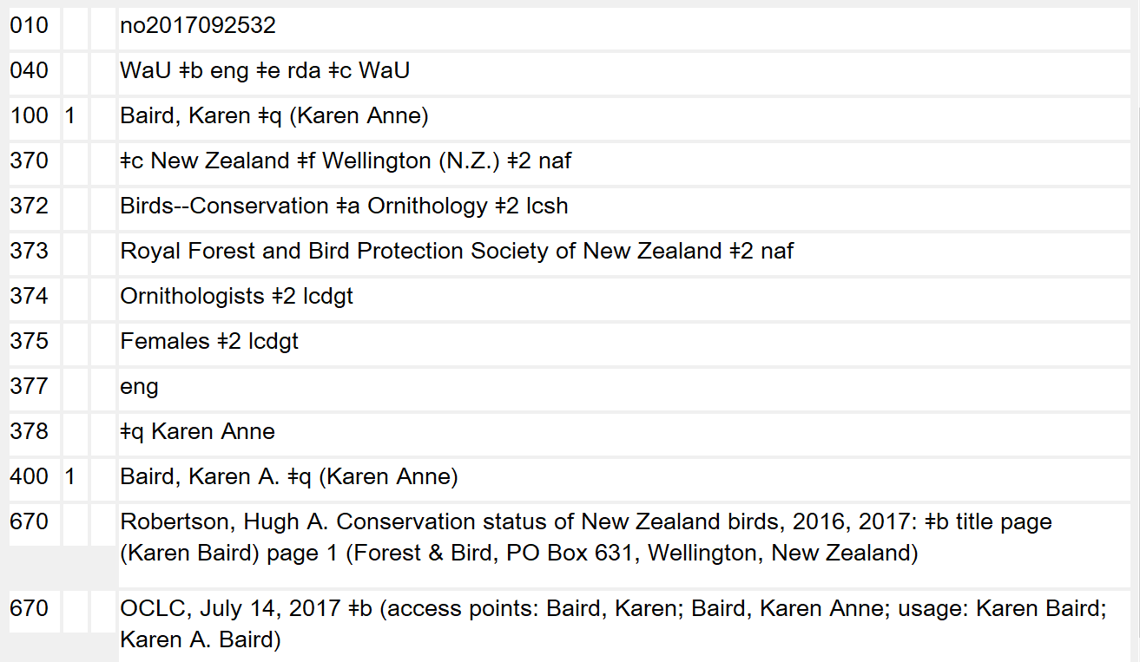
Notes:
October 3, 2024: added note about the 375 field
November 15, 2019
In this example, the preferred name, Karen Baird, conflicts with another person with the same preferred name. Since the fuller form of her given name is known, it is added to the preferred name to create a unique authorized access point. The fuller form is also always recorded in the 378 field.
Note about 375 in case anyone notices: catalogers will encounter existing authority records in which gender has been recorded in field 375. PCC no longer uses this field and it should be deleted when revising an authority for any other reason.

Slide 51
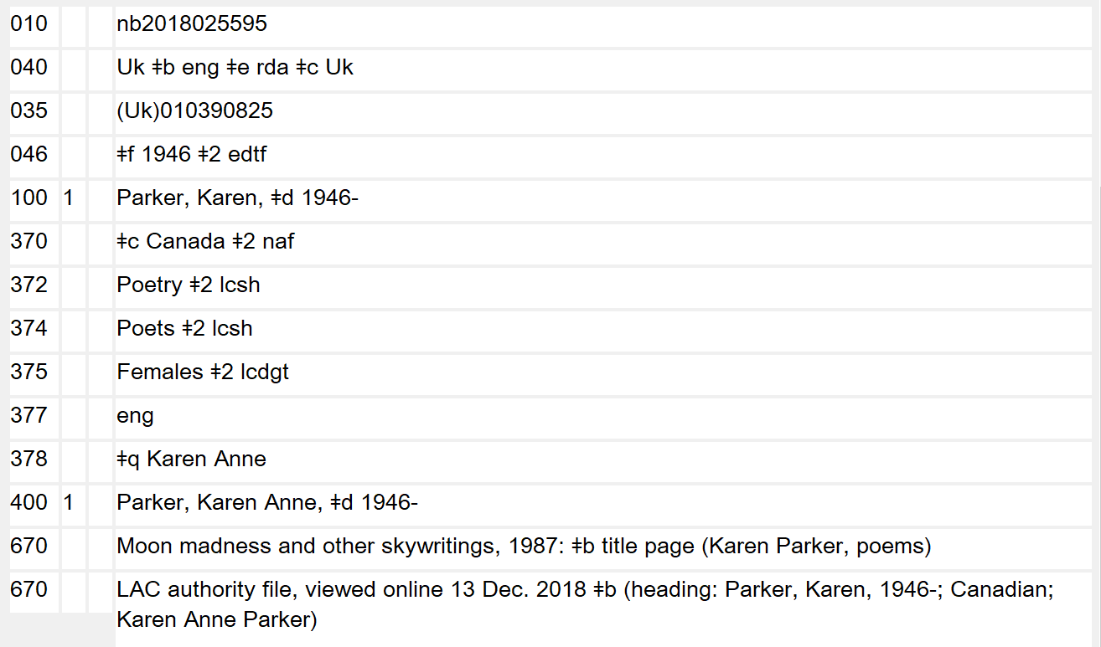
Notes:
October 3, 2024: added note about the 375 field
November 15, 2019
In this example, since the date of birth is known, it is added to the authorized access point, making it unique. The fuller form of her name is also known, but it is only recorded in the 378 field. A variant access point could be (and was) made using the fuller form of name.
Note about 375 in case anyone notices: catalogers will encounter existing authority records in which gender has been recorded in field 375. PCC no longer uses this field and it should be deleted when revising an authority for any other reason.

Slide 52

Notes:
November 15, 2019
In this example, there was no conflict with any other person with the name Karen A. High, but the cataloger has added the fuller form of name to the authorized access point based on their judgment that it aids in identification.

Slide 53
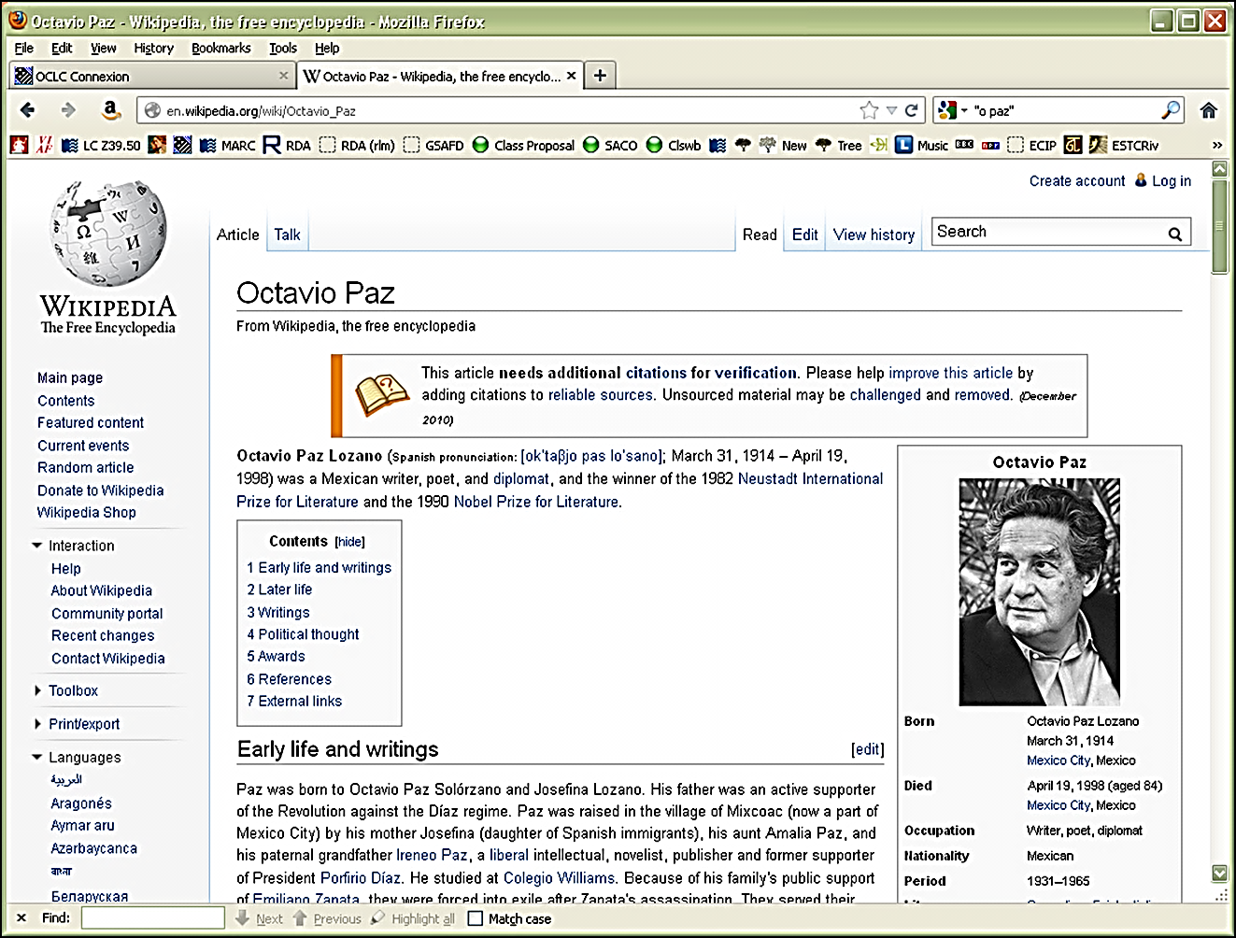
Exercise 3
Notes:
May 1, 2013
EXERCISE 3:
Record dates for Octavio Paz (in the 046 field) and the fuller form of his name (in a 378 field).

Slide 54
Other Designation (RDA 9.6)
Record as separate elements, as parts of access points, or as both
  Saints (RDA 9.6.1.4)
  Spirits (RDA 9.6.1.5)
  Persons named in a sacred scripture or an
  apocryphal book (RDA 9.6.1.6)
  Fictitious and legendary persons (RDA 9.6.1.7)
  Real non-human entities (RDA 9.6.1.8)
  Other designation (RDA 9.6.1.9)
Notes:
Updated February 24, 2014
“Other designation associated with the person” is a term other than a title that is associated with a person’s name.
Some of these are new elements as of the 2013 RDA update.

Slide 55
Other Designation (RDA 9.6)
Record in 368 field, subfield $c. Prefer controlled vocabulary per DCM Z1
  368 $c Saints $2 lcsh
  368 $c Spirits $2 lcsh
  368 $c Angels $2 lcsh
  368 $c Biblical figure
  368 $c Americans $2 lcdgt
  368 $c Fictitious characters $2 lcsh
  368 $c Vampires $2 lcsh
  368 $c Legendary character
  368 $c Greek deity
  368 $c Killer whale $2 lcsh
  368 $c Author of A journey along the national trails of England and Wales
  368 $c Dogs $c Miniature schnauzer $2 lcsh
  368 $c Fictitious characters $c Cats $2 lcsh
  368 $c Fictitious characters $c Muppets (Fictitious characters) $2 lcsh
Notes:
March 4, 2020: added vampires example to illustrate that more specific terms may be used instead of just Fictitious characters
August 2, 2019: added second sentence in bullet and three additional examples showing uncontrolled designations. Changed Whales to Killer whale
“Other designation associated with the person” is recorded in the 368 field, subfield $c. Point out that nationality can be recorded as an “other designation” and suggest that class members add “Mexicans $2 lcdgt” to the Octavio Paz exercise record. (Have class members look at LCDGT in Classification Web or id.loc.gov if they haven’t already done this.)

Slide 56
Other Designation (RDA 9.6)
Core statement in 9.6
  These “other” elements are core in the description (authority record) of the person:
    Christian saint
    Spirit
    Designation of person from sacred scripture or apocryphal book
    Designation of fictitious/legendary person
    Designation of real non-human entity
  Record in MARC 368 subfield $c
Notes:
August 5, 2019: added “or apocryphal book” to third bullet

Slide 57
Other Designation (RDA 9.6)
Requirements for the authorized access point (9.19)
  Qualifier or element required for:
    Phrases (etc.) not conveying the idea of a person
    Certain titles (royalty, etc.)
    Saint
    Spirit
Notes:
December 12, 2016
The elements listed on this slide are required in the authorized access point, whether needed to distinguish the authorized access point or not. Be careful to distinguish these from those of the previous slide, which are required in the description as elements but not all required in the authorized access point.

Slide 58
Other Designation (RDA 9.6)
Otherwise, the qualifier or element is only required if needed to distinguish one access point from another, e.g.,
  (Fictitious character) or (Legendary character) is not required unless needed to distinguish
    Kent, Clark
    Bunyan, Paul
    Mr. Ed
  Qualifier for real non-human entity is not required unless needed to distinguish
    Sir Archy
    Obama, Bo
Notes:
August 5, 2019: moved Mr. Ed example because Mr. Ed is not a real horse, he is a fictitious character; replaced Mr. Ed under real non-human entity with Sir Archy
March 1, 2019: replaced Sherlock Holmes with Paul Bunyan

Slide 59
Other Designation (RDA 9.6)
Qualifier may optionally be added to the authorized access point if the cataloger feels it is necessary. Recording the element (in field 368) is recommended in all cases.
    100 1_ Kent, Clark $c (Fictitious character)
    368 $c Fictitious characters $2 lcsh
    100 1_ Bunyan, Paul $c (Legendary character)
    368 $c Legendary character
    100 0_ Mr. Ed $c (Talking horse)
    368 $c Fictitious characters $c Horses $2 lcsh
    368 $c Talking horse
    100 0_ Sir Archy $c (Race horse)
    368 $c Race horses $c Thoroughbred horse $2 lcsh
    100 1_ Obama, Bo $c (Dog)
    368 $c Dogs $c Portuguese water dog $2 lcsh
Notes:
August 5, 2019: corrected second subfield in first 368 of third example. Added Sir Archy example to match previous slide
March 1 2019: replaced Sherlock Holmes with Paul Bunyan, added second 368 to Mr. Ed example
Note: Controlled term from LCSH is available for “Fictitious characters”, but not for legendary characters.

Slide 60
Title of Person (RDA 9.4)
Core element when it is a word or phrase indicative of royalty, nobility, or ecclesiastical rank or office, or a term of address for a person of religious vocation. Any other term indicative of rank, honour, or office is a core element when needed to distinguish a person from another person with the same name. Record the title in field 368 $d, even if not added to the authorized access point.
    100 0_ Benedict $b XVI, $c Pope, $d 1927-
    368 $d Pope $s 2005 $t 2013
    100 1_ Walsh, Joseph-Alexis, $c vicomte, $d 1782-1860
    368 $d vicomte
    100 0_ Fawziya, $c Queen, consort of Mohammad Reza Pahlavi, Shah of Iran, $d 1921-2013
    368 $d Queen, consort of Mohammad Reza Pahlavi, Shah of Iran $d Princess, daughter
    of Fuʼād I, King of Egypt
    100 1_ Bradford, Mark, $c Reverend
    368 $d Reverend
    100 1_ Arnott, Georgina
    368 $d Dr
    100 1_ Elgar, Edward, $d 1857-1934
    368 $d Sir
Notes:
November 15, 2019
Titles of a person are recorded in 368 $d, whether they also are included in the authorized access point or not.
First example: If a title was only held for a portion of a person’s life, $s and/or $t can be given with the date(s) the title was held.
Third example: if a person has held multiple titles, each can be recorded in a separate 368 $d
Fourth example: the title “Reverend” was included the authorized access point to break a conflict with a different person named Mark Bradford. Use the title as found in usage. For example for a person who uses the abbreviation “Rev.” instead of the full form, use the abbreviated form of the title in the 368 $d and in the access point if it is being added to that.
Fifth example: this person does not use a period in the abbreviation of “Dr”. Follow the usage of the person or form found in reference sources.

Slide 61
Profession or Occupation (RDA 9.16)
Class of persons engaged in the profession or occupation
Record in the 374 field
Prefer controlled vocabulary (LCDGT, LCSH, MeSH, AAT, ERIC, DOT, ONET, etc.)
Add to the authorized access point only if needed to differentiate otherwise identical names or when needed for a name that does not convey the idea of a person.
  100 0_ 50 Cent $c (Musician)
  100 0_ Stone Mountain $c (Writer)
  100 0_ Katfish $c (Comedian)
  100 1_ Jones, Adele $c (Lecturer in English)
  100 1_ Jones, Adele $c (Romance fiction writer)
Notes:
March 8, 2019: added examples
If date of birth and/or death are not available to distinguish one access point from another, record the person’s profession or occupation (9.19.1.6) or when needed to clarify that the name represents a person (9.19.1.1). Profession or occupation may also be recorded in field 374 even when other distinguishing information is available that will be used in the authorized access point.
AAT = Art & Architecture Thesaurus Online: http://www.getty.edu/research/tools/vocabularies/aat/
ERIC Thesaurus = Education Resources Information Center Thesaurus: https://eric.ed.gov/?ti=all
DOT = Dictionary of Occupational Titles: http://www.occupationalinfo.org/
ONET = Occupational Information Network: https://www.onetonline.org/

Slide 62
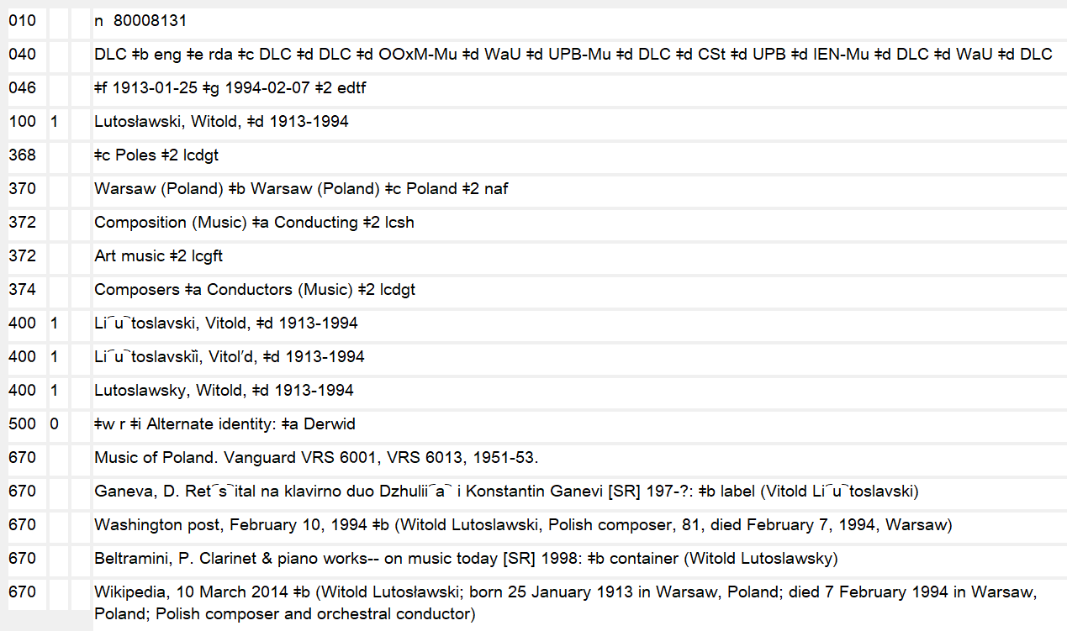
Profession or Occupation
Notes:
October 3, 2024: replaced image with new one without field 375
May 28, 2024 blacked out gender field
September 17, 2018: updated image
March 20, 2017: updated speaker notes to replace LCSH with LCDGT
DCM Z1 states that controlled vocabulary, such as LCDGT or MeSH, is preferred, recording the source in subfield $2. For consistency, capitalize the first term in each subfield $a. When terms do not come from a controlled vocabulary, use a singular form. So following the PCC best practice, we would use “Composers” and “Conductors (Music)” with $2 lcdgt.

Slide 63
Profession or Occupation (RDA 9.16)
Do not record terms qualified by gender, nationality, ethnicity, religion, sexual orientation, or other characteristics that are not strictly occupational. However, inherently gendered occupation terms (e.g., Nuns) may be used if nothing else is suitable.
374 Novelists $2 lcsh
not 374 Women novelists $2 lcsh
374 Lawyers $2 lcsh
not 374 African American lawyers $2 lcsh
Notes:
January 23, 2023: remove gender
May 25, 2016
In field 374, do not record terms that go beyond just the person’s profession or occupation. One doesn’t train to become a woman physician or an African American painter. Assign terms that group all the members of a profession together, rather than separating them out by gender, nationality, ethnicity, religion, sexual orientation, or other characteristics that are not strictly occupational. Other demographic characteristics may be recorded in 368 $c (Other designation) if the cataloger deems them important.
Additional examples from LCSH:
374 Businesspeople not Businessmen not Businesswomen not Jewish businesspeople
374 Authors not Catholic authors not Authors, Belgian not Deaf authors not Older authors
374 Journalists not Chinese American journalists not Journalists, Arab not Gay journalists
374 Singers not Women singers not African American singers not African American women singers not Male singers not African American male singers

Slide 64
Profession or Occupation (RDA 9.16)
Nationality, ethnicity, religion, sexual orientation, or other demographic characteristics unrelated to profession/occupation or gender may be recorded in 368 $c (Other designation) if considered important
368 $c African Americans $c Christians $c Deaf people $2
lcdgt
374 Lawyers $2 lcdgt
not
374 African American women lawyers $a Christian lawyers $a Deaf lawyers $2 lcsh
Notes:
October 15, 2024: changed “Deaf” to “Deaf people” (LCDGT heading changed in June 2024)
January 23, 2023: remove gender
May 25, 2016
MARC 368 $c (Other designation) may be used for demographic characteristics of a person other than profession/occupation or gender, which have their own MARC fields.
Example in slide illustrates characteristics recorded for a deaf Christian African American woman lawyer. Record such other designations if the cataloger considers them important and the person either self-identifies with them or is identified with them in reliable reference sources.

Slide 65
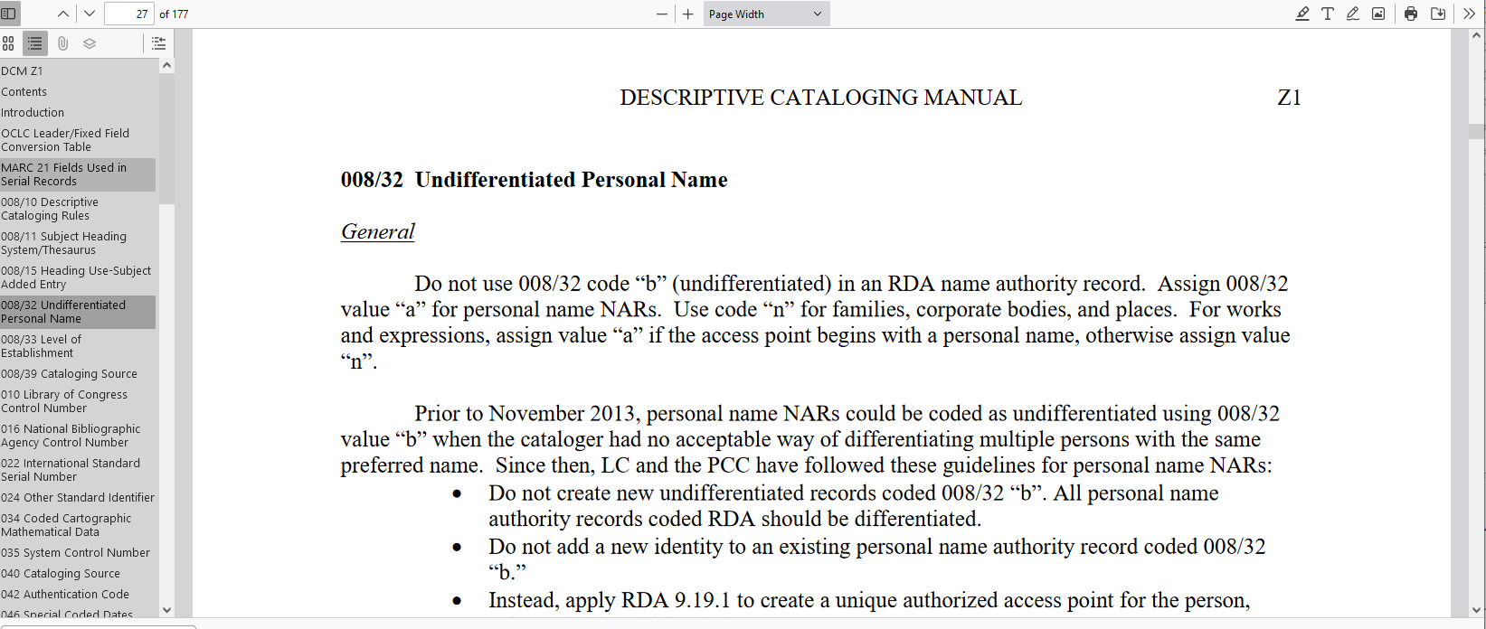
PCC policy on undifferentiated names
DCM Z1 008/32
Notes:
December 12, 2016
15 May 2024 replaced image.
After the expansion of 9.19 a few years ago, the Program for Cooperative Cataloging concluded that it was now possible to stop creating and using undifferentiated records in the LC/NACO authority file. Undifferentiated records are authority records that represent more than one person. Documentation of this change is found in the Library of Congress’s Descriptive Cataloging Manual.

Slide 66
PCC policy on undifferentiated names
Although RDA allows recording undifferentiated personal names (8.11 and 9.19.1.1), PCC policy no longer allows it in the LC/NACO authority file
Do not add any new names to existing undifferentiated name records
Instead, use one of the newly available elements to qualify (i.e., differentiate) the personal name
Notes:
February 24, 2014
RDA does allow undifferentiated descriptions of persons—this is the only instance in RDA where multiple entities can be described using a single description. Undifferentiated descriptions of corporate bodies, families, place names, works, expressions, and so on, are not provided for in RDA. However, PCC policy no longer allows the use of undifferentiated descriptions of persons. The new policy is not to add any new names to existing undifferentiated name records, and not to create any new ones. Instead, the cataloger is to use one of the newly available elements described above to qualify the name.

Slide 67
PCC policy on undifferentiated names
When an access point for a person is needed and that person is represented on an undifferentiated name record
  Create a new authority record for the person with differentiating characteristic(s)
  Include on the new record:
    667 ## $a Formerly on undifferentiated name record: [LCCN of undifferentiated name record]
  Remove the person from the undifferentiated record
Notes:
February 24, 2014
If an access point is needed for a person represented on an undifferentiated record, the NACO cataloger is to create a new authority record for the person, including in the description a note saying the name was formerly on an undifferentiated record, and then remove the person from the undifferentiated record.

Slide 68
PCC policy on undifferentiated names
Once you have removed the name, if only one person is left on the record, do not convert the record to a differentiated record. Instead, either
  Add to the undifferentiated record:
    667 ## $a Last identity on undifferentiated record; reported for deletion.
  Report the undifferentiated record to naco@loc.gov for deletion (LC will create a new record for the remaining person)
  or
Notes:
February 24, 2014
This process will often lead to only one person being left on an undifferentiated record. In the past, this record has simply been recoded as a differentiated record. We will no longer be reusing undifferentiated records in this way to represent the last person on a record—this has caused too many problems with machine manipulation of the file. Instead, the cataloger will either report the record to LC as described here, after which LC will create a new differentiated record for the person and delete the old record, or

Slide 69
PCC policy on undifferentiated names
Alternative:
  Create a new record for the remaining person with differentiating characteristics (birth date, etc.)
  Add to the undifferentiated record:
    667 ## $a Last identity on undifferentiated record; reported for deletion in favor of [LCCN of new record already created].
  Report the undifferentiated record to naco@loc.gov for deletion, informing them that you have created a new record for the remaining person
Notes:
February 24, 2014
The cataloger will create a new record for the remaining person (assuming there is information, such as a birth date or something else, that would make the authorized access point for the person different from that used in the undifferentiated record), and then report the undifferentiated record to LC for deletion as described here.
You might want to do this if you have differentiating information beyond the name (birth date, fuller forms, etc.) for the last remaining person.

Slide 70
Other Attributes
Record in MARC fields
  370 Associated Place (RDA 9.8-9.11)
  371 Address (RDA 9.12)
  372 Field of Activity (RDA 9.15)
  373 Affiliation (RDA 9.13)
  375 Gender (RDA 9.7) Do not use
  377 Language (RDA 9.14)
  678 Biographical Information (RDA 9.17)
  010/024 Identifier for Person (RDA 9.18)
Notes:
October 3, 2024: added 375 back in the slide but with note not to use and revised instructor note
January 23, 2023: removed 375 gender
August 5, 2019: added Identifier for person element
December 12, 2016: removed “new” from slide; added missing elements; added RDA section numbers; and revised speaker notes
These attributes are not added to authorized access points but recording them, if readily available, in RDA authority records is recommended by PCC since they are important to the description of the person and additionally might help with identification. However, in 2022 PCC ceased recording gender in field 375.
DCM Z1 375: Do not use this field in new authority records. Whenever an existing record must be changed for any reason, delete any occurrence of field 375.

Slide 71
Associated Place (RDA 9.8-9.11)
Place
  ⬧ Place of birth and/or death (370 $a and $b)
  ⬧ Country associated with the person (370 $c)
  ⬧ Place of residence (370 $e)
  ⬧ Other associated place (370 $f)
For jurisdictions and other places in LC/NAF: use the established form if in the NAF; if not found: record preferred name but no need to create a new NAR
For non-jurisdictions: place names from LCSH or other vocabularies may be recorded
Indicate the source of the place in subfield $2:
  370 San Francisco (Calif.) $2 naf
  370 Transylvania (Romania) $2 lcsh
Do not mix different vocabularies in a single 370 field
Notes:
August 12, 2019: revised second and third bullets and added final bullet
Example: Geographic name in LC/NAF:
151 Shiner (Tex.)
Form of name in 370:
370 Shiner (Tex.) $2 naf
Place of birth: RDA 9.8; MARC 370 $a
Place of death: RDA 9.9; 370 $b
Country or countries associated with the person: RDA 9.10; 370 $c
Place or places (town, city, province, state, and/or country) in which the person resides or has resided: RDA 9.11; 370 $e
Other associated place: 370 $f. $f is typically used for places of employment, burial places, and other places that don’t fit into any of the other subfields.
If the place name has not been established, you do not need to establish it (though you may); record the name in the form it would have had if it had been established, but do not include $2 naf since it’s not in the authority file.
$2: Code from: Subject Heading and Term Source Codes.

Slide 72
Recording the Associated Place: Exercise 4
Octavio Paz was born and died in Mexico City. He lived parts of his life in Spain, the United States, India, and France.
Notes:
March 1, 2019: changed “p.” to “pages” in notes
EXERCISE 4:
Record information about places associated with Octavio Paz on your worksheet.
Reference for places: The collected poems of Octavio Paz, 1957-1987, 1991: page xiii (Spain) page xiv (United States) page xv (Mexican Ambassador to India in 1962)
Wikipedia, November 5, 2012 (Octavio Paz; Octavio Paz Lozano (March 31, 1914-April 19, 1998); Mexican poet, writer, and diplomat; lived in U.S., France, Spain, India, etc.)

Slide 73
Address (RDA 9.12)
Postal address of the person’s place of residence, business, or employer
  ⬧ Based on cataloger’s judgment but generally do not record physical addresses for living people
Record in the 371 field
  E-mail address in $m
371 P.O. Box 60 $b Tetonia $c Idaho $e 83452 $m dan@danburr.com
Not required to maintain when updating a record
Notes:
November 15, 2019: revised third bullet of DCM Z1 best practice to match current text
August 5, 2019: added 371 coded example
MARC field 371: If only a city or a country of residence is available for a person, that information logically would be better suited in a 370 field.
DCM Z1, 371:
Best practice:
• Supply based on cataloger’s judgment, if the information is readily available and not already being recorded in field 370 subfield $e (Place of residence/headquarters).
• In cases where subfield $a is not recorded, include at a minimum subfield $m (Electronic mail address) or subfield $b (City).
• Do not record physical addresses for living people.
• Catalogers are not required to maintain address information when updating a record that contains an address.

Slide 74
Field of Activity (RDA 9.15)
Person’s field of endeavor, area of expertise, etc.
Record in the 372 field
Never part of an access point
Prefer controlled vocabulary, such as LCSH or MeSH
If using a subject heading with subdivisions, use two hyphens with no spaces between the parts of the string
  372 Japan--History--To 1600 $2 lcsh
  372 Measles--epidemiology $2 mesh
  372 Crops--Ecology $2 fast
If using entity from NAF, remove subfield coding but otherwise keep all punctuation:
  372 Bible. New Testament $2 naf
  372 Lincoln, Abraham, 1809-1865--Childhood and youth $2 lcsh
Notes:
November 15, 2019: added text from DCM Z1 to notes
August 5, 2019: added FAST example
March 1, 2019: added final two bullet points
Information on field of activity can be taken from any source.
DCM Z1 372:
Prefer controlled vocabulary, such as LCSH or MeSH, recording the source in subfield $2. For consistency, capitalize the first term in each subfield $a. Field of activity is not recorded as part of an access point (RDA 9.15.1.3).
If using an LCSH subject heading string for field of activity, replace the subfield coding for the subdivision(s) with two hyphens and close up the spaces between the main heading and subdivision(s).
If using an entity from the LC/NAF for field of activity, remove any subfield coding not authorized for use in the 372 field.
If the only addition to an existing field is an additional term from the same vocabulary, repeat the affected subfield. If the vocabulary source differs, or if another associated element differs (such as a range of dates), repeat the field.
Note: the Lincoln example is coded LCSH because the full string is authorized by LCSH and SCM rules, even though the first element (Lincoln, Abraham, 1809-1865) is from NAF.

Slide 75
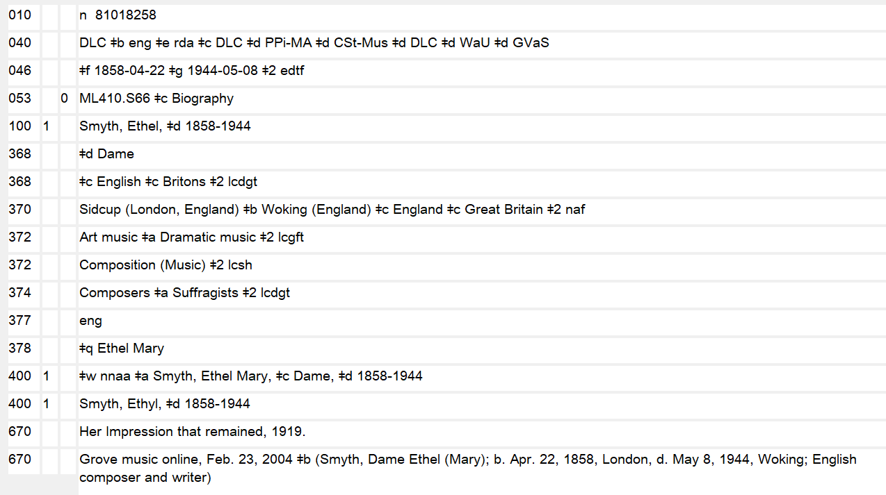
Notes:
October 2, 2024: updated image without 375 field
November 15, 2019
If terms for field of activity come from different controlled vocabularies, repeat the 372 field. The source of the controlled terms is given in subfield $2. The first 372 in the slide shows terms taken from the LC Genre/Form Term list and the second 372 shows a term from LCSH.

Slide 76
Field of Activity vs. Occupation
For a person who is a professor of sociology:
• Field of activity:
372 Sociology $2 lcsh
• Occupation:
374 Sociologists $a College teachers $a Sociology teachers $2 lcsh
and/or
374 Sociologists $a University and college faculty members $a Sociology teachers $2 lcdgt
Notes:
November 15, 2019: revised examples, speaker notes
Field of Activity and Occupation are separate elements. The examples illustrate what might be recorded in a description of a professor of sociology.
DCM Z1 says to prefer controlled vocabulary for both fields in which case indicate the source in subfield $2.

Slide 77
Affiliation
RDA 9.13: Affiliation
Name of group/s with which a person is affiliated or has been affiliated through employment, membership, cultural identity, etc.
Record in the 373 field
Use the established form if found in the NAF; if not found, determine and record the preferred name
373 University of Kansas. School of Education $2 naf
373 Ekosgen (Firm) $2 naf
373 Tim Lorang Consulting
Notes:
November 15, 2019: revised fourth bullet and instructor notes
August 5, 2019: added some examples (two established) and one unestablished
Prefer a controlled vocabulary, such as the LC/NACO Authority File. Subfield coding for subordinate bodies is not used in the 373 field.
MARC field: 373
$a - Associated group
$s - Start period
$t - End period
$u - Uniform Resource Identifier
$v - Source of information
$2 - Source of term
If not in the NAF and you use the preferred form of the name of the group, there is no need to establish it, though you may. If the name is not established, do not include $2 in the 373 field. Note that only the preferred name is recorded, not the form the authorized access point would be if established, which could include qualifiers. Example: 373 Blue Canoe If it were established, its authorized access point would be Blue Canoe (Firm).

Slide 78
Language of the Person (RDA 9.14)
Language/s the person uses when writing for publication, broadcasting, singing, etc.
Record in the 377 field
Use codes from the MARC Code List for Languages
Encode multiple languages if more than one language is used for publication, communication, etc.
Notes:
November 15, 2019: revised instructor notes
Language of the person is a language used by the person in creating or contributing to a resource. Not languages a person knows, speaks at home, etc. Only languages that would be coded in bib records for works and expressions created or contributed to by the person.
Prefer language codes over language terms, using codes from the MARC Code List for Languages available at: http://www.loc.gov/marc/languages/langhome.html
Code in MARC field 377 $a. Use subfield $l (Language term) only if the MARC code for the particular language is not available in the MARC Code List for Languages and a collective MARC code is recorded in $a. For example for a person who creates works in Ronga, MARC uses a collective code “bnt” for Bantu (Other). In this situation, both $a and $l are used: 377 bnt $l Ronga
Subfield $2 is not required when the MARC Code List for Languages is used as the language source code.
Another option if the particular language code is not available in that list is to supply an additional 377 field from another language code list and use the second indicator value "7" with subfield $2 containing a code for a language source list (use the list of MARC-registered language lists in Language code and term source codes: http://www.loc.gov/standards/sourcelist/language.html).
For example:
377 __ bnt $l Ronga
377 _7 rng $2 iso639-3
377 _7 rong1268 $2 glotto
“rng” is the ISO 639-3 code for Ronga; “rong1268” is the code for Ronga in Glottolog. In the MARC Code List for Languages, Ronga is included in the collective code “bnt” for Bantu (Other) languages.

Slide 79
Language of the Person (RDA 9.14)
Consider adding codes from other sources such as ISO 639-3 or Glottolog when MARC does not have a specific language code
377 ## sal $l Clallam
377 ## eng
377 #7 clm $a eng $2 iso639-3
377 #7 clal1241 $a stan1293 $2 glotto
Example: Languages of person are Clallam and English:
Notes:
October 15, 2024: new slide
The languages of this person are Clallam and English. Clallam does not have its own MARC code. The MARC code “sal”, a collective code for Salishan languages, is used instead.
When a collective code is used, the specific language can be recorded in subfield $l.
However, ISO 639-3 and Glottolog have codes specifically for the Clallam language. The cataloger decided to add codes from both these language code lists.

Slide 80
Biographical Information (RDA 9.17)
Information pertaining to life or history of a person
Record in the 678 field, first indicator “0”
⬧ 678 0_ [Entity’s name in direct order] (date of entity) is/was a [description of the entity].
Formulate appropriately for display in public catalogs
  Upgrade old 678 notes to contain full sentences when adding biographical information
Information needs to be justified elsewhere in the NAR
Notes:
May 1, 2013
Please note the preferred format of the 678 field.
The information in the note needs to be justified elsewhere in the NAR, either in separate specific fields or in one or more 670 fields.
The 678 field was previously used to preserve useful biographical/historical information pertaining to the 1XX when manual NARs and SARs were converted to machine-readable form. When adding biographical or historical information to NARs, the 678 note field should be upgraded to contain full sentences.

Slide 81
Biographical Information (RDA 9.17)
Examples:
678 0 Rudolf Moralt (1902-1956) was a German composer and music conductor.
678 0 Charlie Chan is a fictional Honolulu Police Department detective, created by Earl Derr Biggers, who travels the world investigating mysteries and solving crimes. The character was inspired by the real-life Honolulu detective Chang Apana.
678 0 Georgia O'Keeffe (November 15, 1887-March 6, 1986) was an American artist. She is best known for her paintings of enlarged flowers, New York skyscrapers, and New Mexico landscapes. O'Keeffe met the photographer Alfred Stieglitz in 1917 and, after he divorced his first wife, married him in 1924.
Notes:
August 5, 2019

Slide 82
Identifier (RDA 9.18)
A character string uniquely associated with a person or with a surrogate such as an authority record for a person
LCCN associated with an authority record is an identifier, automatically recorded in 010
024 (Other Standard Identifier) can also be included
See DCM Z1 024 and NACO 024 Best Practices Guidelines
Notes:
October 3, 2024: updated third bullet to remove statement on moratorium
August 5, 2019
NACO 024 Best Practices Guidelines: https://www.loc.gov/aba/pcc/naco/documents/NACO-024-Best-Practices.pdf

Slide 83
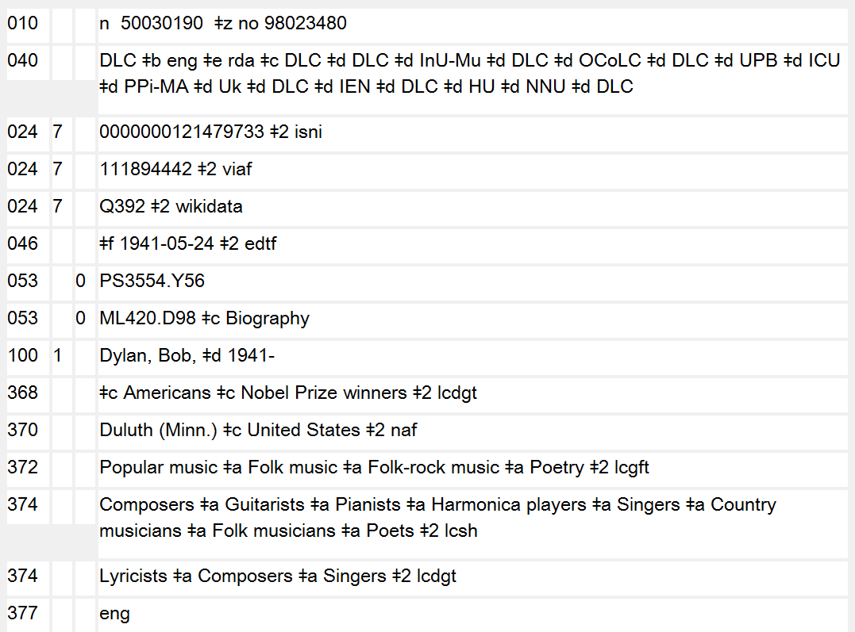
Notes:
October 3, 2024: updated notes to remove statement on moratorium on adding identifiers in 024
February 28, 2020: updated notes
Example of NAR with LCCN in 010 and other standard identifiers in 024.
In case anyone notices: there is also a $z in the 010, which represents the LCCN of a cancelled name authority record that was a duplicate record.

Slide 84
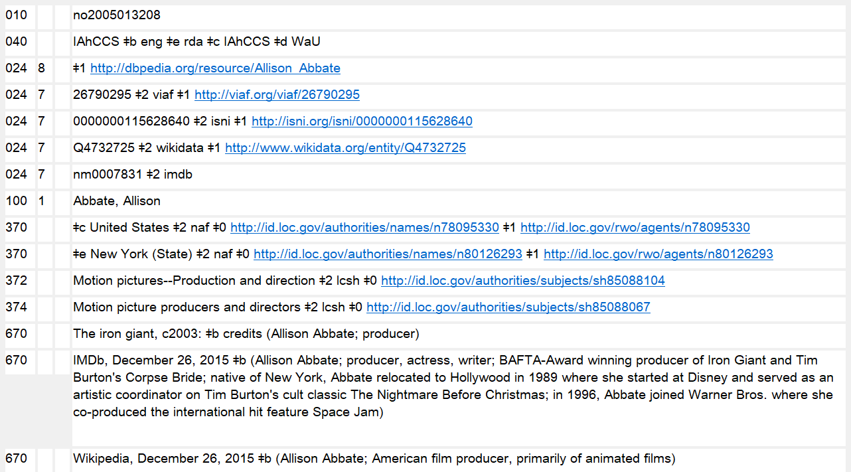
URIs in 024
Notes:
October 3, 2024: updated image to delete 375 and 667 note about URIs that is no longer made; updated instructor note
August 16, 2023: updated notes to indicate that URIs may be added to authority records
February 28, 2020: new slide
URIs may be found included in 024, 3XX, and 5XX fields, in subfields $0 and/or $1. They may be added by NACO participants. They should not be removed or edited unless incorrect. $0 points is used for links to authority records. $1 is used for real world object URIs. The PCC is developing guidelines for including $0 and $1 in both bibliographic and authority records. For 024, follow the NACO 024 Best Practices Guidelines: https://www.loc.gov/aba/pcc/naco/documents/NACO-024-Best-Practices.pdf
During the PCC URI MARC Pilot, a 667 note was added to NARs: “URIs added to this record for the PCC URI MARC Pilot. Please do not remove or edit the URIs.” This note should no longer be used, and may be deleted from existing NARs when an NAR is being revised.

Slide 85
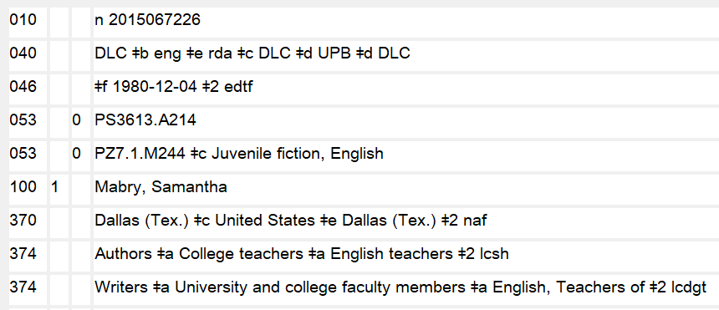
Classification Number
Class numbers for literary authors may be recorded in field 053
See NACO training module 1 for details
Notes:
October 3, 2024: new slide
Reminder: Module 1 covered the use of authority field 053 to record LC classification numbers for literary authors.

Slide 86
Recording Attributes of a Person: Exercise 5
Octavio Paz taught at Cambridge University, the University of Texas at Austin, and Harvard
He wrote in Spanish
He was a poet and diplomat
Notes:
May 1, 2013
EXERCISE 5:
1. Record Paz’s affiliation.
Reference for affiliation: The collected poems of Octavio Paz, 1957-1987, 1991: p. xv (“Paz taught at Cambridge University, the University of Texas, and Harvard”)
2. Record language attribute on the worksheet.
3. Record Octavio Paz’s occupation and field of activity (whatever you think is appropriate).

Slide 87
Access Points Representing Persons
Notes:
May 1, 2013

Slide 88
Access Points: Terminology (RDA 8.1.4)
Access point:
Name, term, code, etc., representing a specific person
Authorized access point:
Standardized access point representing an entity; uses the preferred name for the person
Variant access point:
Alternative to the authorized access point representing an entity
Notes:
December 12, 2016: removed “constructed using a variant name for that person” from third bullet point per November 2016 RSC decision
Until now we have been discussing the elements identifying a person and how to construct them. Instructions on constructing Access Points for Persons (called headings in AACR2) using these elements are in the last section of Chapter 9 (i.e., 9.19).

Slide 89
Constructing Authorized Access Points (RDA 9.19.1)
Use the preferred name as the basis (see RDA 9.2.2)
Additions to the name
  ⬧ Always make additions specified in RDA 9.19.1.1, RDA 9.19.1.2.1-5, and RDA 9.19.1.3
  ⬧ The additions specified in RDA 9.19.1.2.6 and 9.19.1.4-9.19.1.8 are required only if need to distinguish
Notes:
November 24, 2015
Preferred name for the person: RDA 9.2.2
For persons, the preferred name is the basis for the authorized access point. Possible additions to the preferred name with a prescribed order are described in RDA; in the instruction for each of those elements, there is a link back to the element itself for guidance on how to construct the element.
Even though the RDA 9.19.1.3 instructs catalogers to add the date of birth and/or date of death, if necessary, to distinguish one access point from another, LC-PCC PS for 9.19.1.3 instructs us to follow the RDA option and add a date of birth and/or date of death if available when establishing the authorized access point even if not needed to distinguish between access points.
If an addition, such as fuller form of name, and/or profession or occupation, is needed to differentiate the access point for one person from the access point for another (either because dates of birth/death are not available or because there is still a conflict), apply cataloger judgment in the choice of the other attribute to add. There is no priority order (the priority order in RDA 9.19.1.1 was removed in the 2014 RDA revision).
Note: The RDA practice for adding fuller form of name varied during the test period and the first couple of years after. The current LC-PCC policy allows catalogers to add a fuller form of name if considered important for identification (LC‐PCC PS for 9.19.1.4, Option (Fuller form of name)).

Slide 90
Required Additions to the Preferred Name
Title or Other Designation (RDA 9.19.1.2) – add as applicable
  a title of royalty (RDA 9.4.1.4 / 9.19.1.2.1) or nobility (RDA 9.4.1.5 / 9.19.1.2.2)
  the term Saint (RDA 9.6.1.4 / 9.19.1.2.4)
  a title of religious rank for a person with only a given name (RDA 9.4.1.6-9.4.1.8 / 9.19.1.2.3)
  the term Spirit (RDA 9.6.1.5 / 9.19.1.2.5)
A term indicating profession or occupation (RDA 9.16 / 9.19.1.1) for a person whose name consists of a phrase or appellation not conveying the idea of a person
  55 $c (Rapper) Drawing Room $c (Musician)
  Stone Mountain $c (Writer) Dynamite $c (Comedian)
Notes:
March 1, 2019: added access point instruction numbers to each bullet and added examples to last bullet point
This slide shows required additions to the authorized access point.
Exceptions:
Title of nobility. Add a title of nobility only if the title or part of the title commonly appears with the name in manifestations associated with the person or in reference sources. Disregard, in this context, reference sources dealing with the nobility. In case of doubt, add the title.
Saint. Do not add Saint to an access point representing a pope or an emperor, empress, king, or queen.

Slide 91
Additions to the Preferred Name if Needed to Differentiate:
Profession/Occupation (RDA 9.19.1.6)
Other Term of Rank, Honour, or Office (RDA 9.19.1.7) Other Designation (RDA 9.19.1.2.6, 9.19.1.8)
  a term indicating a person named in a sacred scripture or an apocryphal book (9.6.1.6 / 9.19.1.2.6)
  the term Fictitious character, Legendary character, etc. (9.6.1.7 / 9.19.1.2.6)
  a term indicating type, species or breed (9.6.1.8 / 9.19.1.2.6)
  other designation (9.6.1.9 / 9.19.1.8)
  a term indicating profession or occupation (9.16 / 9.19.1.6)
  other term of rank, honour, or office (RDA 9.4.1.9 / 9.19.1.7)
Notes:
November 15, 2019: added instruction numbers to each bullet
This slide shows additions to authorized access points that are required only if needed to differentiate.
Remember, the term indicating profession or occupation is required if the person’s name does not convey the idea of a person. Otherwise it is not required, but may be used to differentiate.
Other designation can include just about anything, including “Author of …”
Other term of rank, honour, or office (e.g., Sir, Reverend, Ph. D.) is added to an authorized access point if it appears with the name and is needed to differentiate. In new authority records, this may be added if the cataloger considers it important for identification; do not add to or remove from an existing authorized access point unless otherwise changing the access point (LC-PCC PS 9.19.1.7).
Likewise, elements in RDA 9.6 may be added to an authorized access point in new authority records if the cataloger considers it important for identification. In existing authority records, do not add or remove an Other Designation unless otherwise changing the access point (LC-PCC PS 1.19.1.2.6).

Slide 92
Additions to the Preferred Name:
Other Designation Examples
Fabius, $c of Caesaria, Saint
Garland, Judy $c (Spirit)
Adam $c (Biblical figure)
Fletcher, Jessica $c (Fictitious character)
Wilgefortis, $c Saint (Legendary character)
Tlazolteotl $c (Aztec deity)
Lauder Lass $c (Horse)
Palmer, William E. $c (Of the North American Rockwell Corporation)
Mitchell, Angus $c (Brother of Alison Mitchell)
Li, Weishi $c (Ph. D. in physics)
Notes:
November 15, 2019: added some additional examples and subfield coding; added instructor note
other designation associated with person▼: A term other than a title that is associated with a person
Other designations (RDA 9.6) include:
Saints
Spirits
Persons Named in Sacred Scriptures or Apocryphal Books
Fictitious and Legendary Persons
Real Non-human Entities
Other Designation - a catch-all for anything designation that doesn’t fit any of the other categories
The last example (Ph. D. in physics) is an other designation, not a term of rank, honour, or office (9.4.1.9 and 9.19.1.7). “Ph. D.” by itself, however, is considered a term of rank, honour, or office. Titles and terms of rank, honour, or office are not enclosed in parentheses and preceded by a comma: Liu, Zhen, $c Ph. D.

Slide 93
Additions to the Preferred Name
Date of birth (RDA 9.19.1.3 and 9.3.2) and/or date of death
  Always add if available when establishing the authorized access point
  Dates are always added as the last element of an access point unless “(Spirit)” is being added
Period of Activity (RDA 9.19.1.5 and 9.3.4)
  Add only if need to differentiate
Notes:
March 1, 2019: added clarification about order of elements in access points
Go to LC-PCC PS for 9.19.1.1 for the PCC practice on giving dates for persons:
Birth/death date: Date of birth and Date of death are core elements, and are always added to newly established access points when known.
If giving both a date of birth and a date of death or giving a span of dates for period of activity, separate the dates with a hyphen. If giving only a date of birth, use a hyphen after the date; do not use the term “born” with the date. If giving only a date of death, use a hyphen before the date; do not use the term “died” with the date.
Period of activity: If the person’s date of birth and date of death are both unknown, record a date or range of dates indicative of the person’s period of activity. Use “active” and “century” per LC-PCC PS (disregard the RDA examples that use ”flourished”). The term "active" should appear before the first period of activity date (e.g., "active 12th century”).
Order of elements in access point: This is PCC policy, not RDA. See DCM Z1, 100 field.
Next slide: examples.

Slide 94
Additions to the Preferred Name: Dates (RDA 9.3, 9.19.1.3, LC-PCC PS 9.3.2.3, 9.3.3.3)
Smith, John, $d 1924-
Smith, John, $d 1900 January 10-
Smith, John, $d 1836 or 1837-1896
Smith, John, $d approximately 1837-1896
Smith, John, $d 1837-approximately 1896
Smith, John, $d approximately 1837-approximately 1896
Smith, John, $d 1825-
Smith, John, $d -1859
Bach, Johann Sebastian, $d 1685-1750 $c (Spirit)
Wang, Jian $c (College teacher), $d 1971-
Lestat $c (Vampire), $d 1760-
Johnson, Carl F., $d active 1893-1940
Joannes, Diaconus, $d active 12th century
Joannes, Actuarius, $d active 13th century-14th century
Notes:
October 15, 2024: added note about the same year followed by a hyphen and preceded by a hyphen normalizing to the same thing
November 15, 2019: added Lestat example and subfield coding
March 1, 2019: added Bach and Wang examples
RDA Appendix B does not contain any abbreviations for months. Other terms associated with dates that were abbreviated in AACR (b., d., fl., cent.) are spelled out if used in RDA records because abbreviations should not be used. “ca.” is replaced by “approximately”.
- 9.3.2 Date of birth is the year a person was born. Date of birth may also include the month and day of the person’s birth. LC-PCC PS for 9.3.1.3: LC practice/PCC practice: Record the month in English.
- 9.3.2.3 Record the person’s date of birth applying the basic instructions on recording dates associated with persons given under 9.3.1. If the person was born in the same year as another person with the same name, record the date of birth in the form [year] [month] [day]. Record the month in the language and script preferred by the agency creating the data. LC-PCC PS for 9.3.2.3: LC practice/PCC practice: Use a hyphen after date of birth when recording the date in an authorized access point; do not use the term “born” with the date.
- 9.3.3 Date of death is the year a person died. Date of death may also include the month and day of the person's death. LC-PCC PS for 9.3.1.3: LC practice/PCC practice: Record the month in English.
- 9.3.3.3 Record the date of death of a deceased person applying the basic instructions on recording dates associated with persons given under 9.3.1. LC-PCC PS for 9.3.3.3: LC practice/PCC practice: Use a hyphen before the date of death when recording the date in an authorized access point; do not use the term “died” with the date.
Note: the various dates associated with a person (birth, death, period of activity) are separate elements in RDA. But because they all map to MARC X00 subfield $d, something extra (e.g., “born”, “died”, or a hyphen between, before, or after) is needed when encoding those RDA elements in access points to give the dates meaning. Other practices would be possible under RDA (e.g. “born 1825” rather than “1825-”)
Note: Smith, John, $d 1825- and Smith, John, $d -1825 mean different things, but they would normalize to the same thing, so cannot both be used as 100s in different NARs, nor can one be a 100 on one NAR and the other a 400 on a different NAR. The cataloger would need to add something else to distinguish two people with the same preferred name one of whom was born and one of whom died in the same year.
Note order of elements. Date always comes last unless “(Spirit)” is present (see Bach example). See also Wang and Lestat examples, where profession or occupation was added because the date was not sufficient to distinguish, and where other designation for fictitious/legendary character was optionally added for better identification; date still comes last.

Slide 95
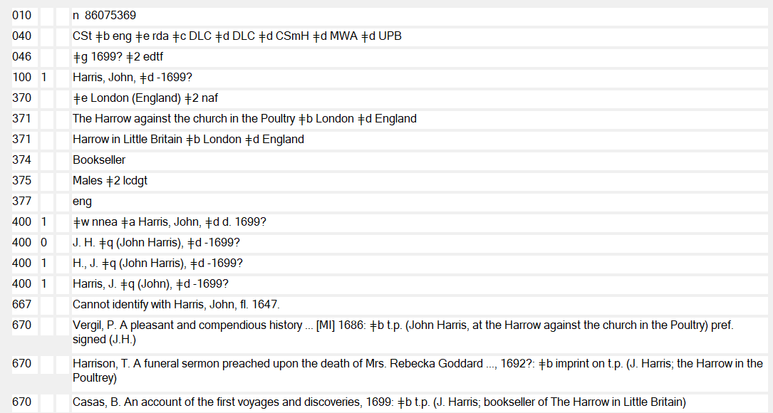
Dates: Recoding to RDA
Notes:
September 17, 2018
When recoding a date that is not appropriate in an access point for RDA, record the AACR2 heading in a 400 field with subfield $w nnea (unless that access point in the 400 happens to be a valid RDA variant access point).

Slide 96
Additions to the Preferred Name
Fuller form of name (RDA 9.19.1.4 and 9.5)
  ⬧ Add if an initial or an abbreviation is used in the given name or surname and it is important for identification (cataloger’s judgment)
  ⬧ Add unused given names or surnames only if need to differentiate
Profession or occupation (RDA 9.19.1.5 and 9.16)
  ⬧ Add only if need to differentiate
Notes:
March 20, 2017: updated to reflect current RDA language
AACR2 headings that include the fuller form of name are RDA acceptable since they are not incorrect from the point of view of the RDA rules (RDA Optional Addition). They should be left in in authorized access points in the NARs recoded to RDA.
This concludes the overview of the additions to the Preferred Name for a person to construct Authorized Access Points. Remember, we are no longer using undifferentiated name records, so we must find a way to differentiate persons with the same name. RDA gives us multiple ways of doing this.

Slide 97
Constructing Variant Access Points (RDA 9.19.2.1)
Use a variant name (RDA 9.2.3) or the preferred name (RDA 9.2.2) as the basis of the variant access point
Make additions to the name
  ⬧ as if it were an authorized access point
  ⬧ when needed to break a conflict with an authorized access point in another record
  ⬧ when needed to break a conflict with another variant access point in the same record
Notes:
September 17, 2018: update first sub-bullet under additions
Any name, including the preferred name, can be used as the basis for a variant access point.
Construct a variant access point as if it were an authorized access point; any or all additions that would be allowed in the authorized access point are appropriate in the variant access point as well.
Note: variant access points in different authority records can be identical (i.e., a 400 in one NAR identical to a 400 in another NAR).
Remember: under RDA, variant access points for a person are optional: “Names and forms of the name not chosen as the preferred name may be recorded as variant names” (9.2).

Slide 98
Additions to the Variant Name
010 no2006019422
100 1_ Hayward, William $q (William L.)
400 1_ Hayward, Bill, $d 1941-2008
(date added to break a conflict with an authorized access point in another record)
010 nr2006006389
100 1_ Cerioni, Giorgio
1_ Greenwood, George $c (Actor)
(occupation/profession added to break a conflict with an authorized access point in another record)
Notes:
May 1, 2013
Here are a couple of examples of additions made to differentiate between the variant access point and the authorized access point for another person.
100 1_ Hayward, William $q (William L.)
400 1_ Hayward, Bill, $d 1941-2008 → CONFLICTS WITH n 93077146
670 __ The hired hand, c2003: $b credits (William Hayward)
670 __ IMDb, 22 Feb. 2006 $b (William Hayward (I), sometimes credited as Bill Hayward, William L. Hayward; producer, 1960s- )
670 __ New York times WWW site, Mar. 24, 2008 $b (in obituary published Mar. 22: William L. Hayward, known as Bill; b. William Leland Hayward III, Mar. 27, 1941, Los Angeles; found dead Mar. 9, Castaic, Calif., aged 66; lawyer and producer whose best-known films include Haywire, a television movie based on a memoir by his sister Brooke about their charmed, tragic Hollywood family)
100 1_ Cerioni, Giorgio
400 1_ Greenwood, George $c (Actor) → CONFLICTS WITH nr 91034190
400 1_ McGraw, George
670 __ Jacob, the man who fought with God, 2005: $b credits (Giorgio Cerioni)
670 __ IMDb, Mar. 10, 2006 $b (Giorgio Cerioni; sometimes credited as George Greenwood, George McGraw; actor)
670 __ Virgilio Cinema website, Mar. 10, 2006 $b (Giorgio Cerioni; actor)

Slide 99
Variant Access Points Based on Preferred Name
100 1_ Andrews, Jeff $c (Physician)
368 __ $d M.D.
374 __ Physicians $2 lcdgt
378 __ $q Jeffrey C.
400 1_ Andrews, Jeff, $c M.D.
400 1_ Andrews, Jeff $q (Jeffrey C.)
Notes:
November 4, 2019
RDA allows you to use a preferred name as the basis of a variant access point, by making different additions to the preferred name from the one in the authorized access point.

Slide 100
Exercise 6
Construct the authorized access point for Octavio Paz and any variant access points
Record the sources consulted on your worksheet
Record all other available information in the appropriate fields
Notes:
May 1, 2013
EXERCISE 6:
Let’s now look at the same two slides we used earlier: the Title Page slide and the Wikipedia slide for Octavio Paz, and finish up the authority record.

Slide 101


Preferred Name?
1957
2003
Notes:
May 1, 2013

Slide 102
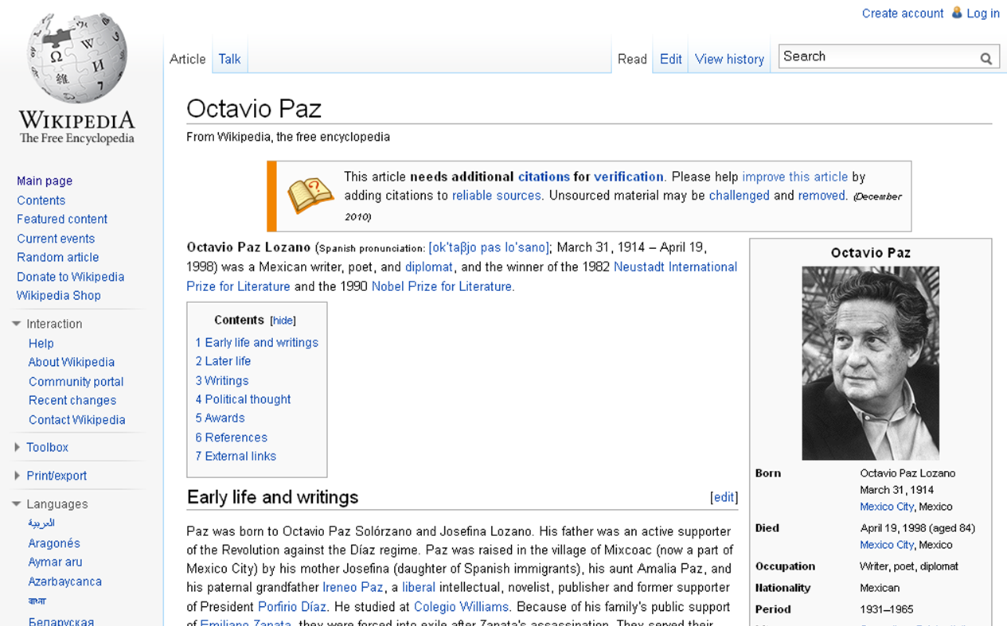
Exercise 6
Notes:
May 1, 2013

Slide 103
Relationships
Notes:
May 1, 2013

Slide 104
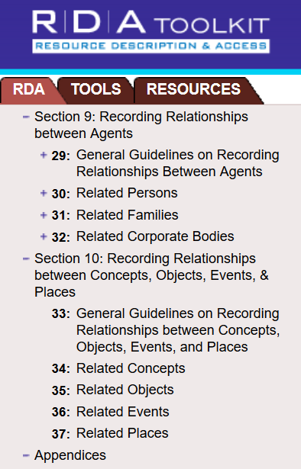
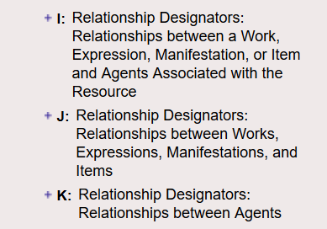
Relationships in RDA
Chapters 18-22, Appendix I
  Between a work, expression, manifestation, or item and associated agents
Chapters 24-28, Appendix J
  Between works, expressions, manifestations, and items
Chapters 29-32, Appendix K
  Between agents
Notes:
March 20, 2017
Relationships are an important part of RDA. Expressing relationships in bibliographic and authority records helps users find what they are looking for and tell users about other available resources. We need to reflect important relationships in our catalogs and resource discovery systems so metadata can be linked to other related resources.
In our NACO work and in this module, we are interested in relationships between entities in Group 2: Persons, Families, and Corporate Bodies, and how these entities relate to each other.
You’ll find the guidelines on recording the relationships between Agents (Persons, Families and Corporate bodies) in Chapter 29. Chapters 30-32 provide more details, description, purpose and scope.

Slide 105
Relationships between Agents
Relationship designators
  ⬧ Use only terms from Appendix K in NARs
    to Relate Persons to Other Persons (Appendix K.2.1)
    to Relate Families to Persons (Appendix K.3.1)
    to Relate Corporate Bodies to Persons (Appendix K.4.1)
Notes:
March 20, 2017: updated to reflect current RDA language; revised final paragraph of notes based on likely workflow
Relationship designators are terms used to describe relationships among resources, persons, families, and corporate bodies. The terms describe relationships between entities represented by authorized access points, descriptions, and/or identifiers.
New relationship elements for the new RDA may be proposed by contacting the PCC Standing Committee on Standards. If the PCC approves, they will submit the proposal to the North American RDA Committee (NARDAC), which, if it agrees, will then forward to the RDA Steering Committee for final consideration.

Slide 106
Relationship Designators
PCC Practice (LC-PCC PS for K.1)
  Record in 5XX fields
  Use subfield $i for a relationship designator and subfield $w with value “r” as the first subfield
  Capitalize the first word in the designator and end subfield $i with a colon
Notes:
May 23, 2018: deleted OCLC $w note from slide. March 20, 2017: updated speaker notes
NACO catalogers may use subfield $i (Relationship information) in NARs to provide relationship information between authorized access points except for multiple pseudonymous (more than two identities) relationships for which simple see-also references (5XX) are used with subfield $w nnnc coding and a 663 note. See LC/PCC Practice for Creating NARs for Persons Who Use Pseudonyms (http://www.loc.gov/catdir/cpso/pseud.pdf)
When otherwise modifying a NAR that contain obsolete codes in a subfield $w, PCC catalogers should upgrade the NAR as appropriate.

Slide 107
Related Corporate Bodies (RDA 32)
100 1_ Zuckerberg, Mark, $d 1984-
510 2_ $w r $i Founded corporate body of
person: $a Facebook (Firm)
100 0_ Andre 3000, $d 1975-
510 2_ $w r $i Corporate body: $a OutKast
(Musical group)
Notes:
May 23, 2018: moved $w to beginning of field in examples and deleted presenter note about $w display in OCLC
December 12, 2016: updated relationship designator in first example, corrected indicator in second

Slide 108
Related Families (RDA 31)
100 1_ Nibley, Hugh, $d 1910-2005
500 3_ $w r $i Descendants: $a Nibley
(Family : $g Nibley, Hugh, 1910-2005)
Notes:
May 23, 2018: Moved $w to beginning of field in example

Slide 109


Related Persons (RDA 30)
Notes:
February 5, 2019: replaced images with higher resolution images.

Slide 110
Related Persons (RDA 30)
100 1_ Bachman, Richard
500 1_ $ w r $i Real identity: $a King, Stephen, $d 1947-
  100 1_ King, Stephen, $d 1947-
500 1_ $ w r $i Alternate identity: $a Bachman, Richard
Notes:
May 23, 2018: moved $w to beginning of field in examples and deleted presenter note about $w display in OCLC
March 20, 2017: updated speaker notes
When creating name authority records for a person with different identities, follow the guidelines in the Descriptive Cataloging Manual Z1 sections for MARC fields 663 and 667. More information is available in the FAQ – LC/PCC practice for creating NARs for persons who use pseudonyms: http://www.loc.gov/catdir/cpso/pseud.pdf
The “$w r + $i [Relationship designator]” is used only in case of 2 identities when only 2 access points and NARs are created for a person.

Slide 111
More than Two Identities
Designate one as a “basic” access point
On the “basic” NAR:
  add 500 “see also” references with a subfield $w “nnnc” for all other names used
  add a 663 field listing all the other names with the following text:
663 For works of this person entered under other names, search also under: $b [name] $b [name], etc.
Notes:
October 15, 2024: added info on choosing the “basic” heading to speaker notes
April 25, 2017: revised 1st sub-bullet
In case of more than 2 identities, a combination of subfield $w nnnc and a 663 field is used instead of the subfields $i [Relationship designator] and $w r.
DCM Z1, 663 Complex See Also Note gives detailed instructions for constructing NARs for persons with more than 2 identities:
On the authority record for the “basic” name authority record add 500 see also references with a subfield w coded “nnnc” from all other names used. Justify the 500 in 670 citations according to normal practice.
From FAQ – LC/PCC practice for creating NARs for persons who use pseudonyms (https://www.loc.gov/catdir/cpso/pseud.pdf): Choose as the basic heading the predominant (most commonly found) form of name. If it is not possible to determine a predominant form choose the real name as the basic heading.

Slide 112
More than Two Identities
On each of the other NARs:
  add a 500 “see also” reference for the “basic” NAR with a subfield $w nnnc
  justify that reference in a 670 citation, according to usual practice
  add a 663 field with the following text:
663 Works by this author are entered under the name used in the item. For a listing of other names used by this author, search also under: $b [basic heading]
Notes:
April 25, 2017: revised 1st sub-bullet

Slide 113
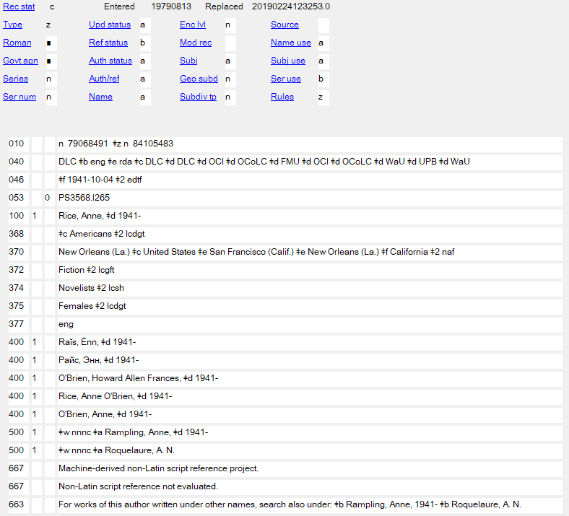
More than Two Identities: Basic NAR
Notes:
March 1, 2019: replaced slide of NAR to correct form in 663

Slide 114
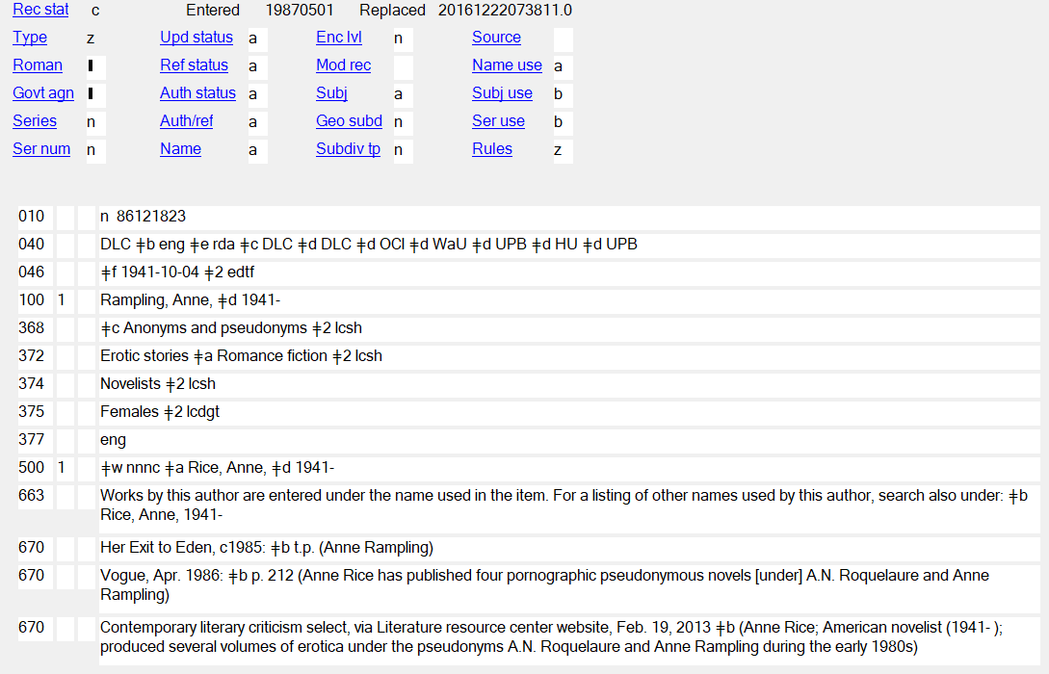
More than Two Identities (2)
Notes:
September 17, 2018

Slide 115
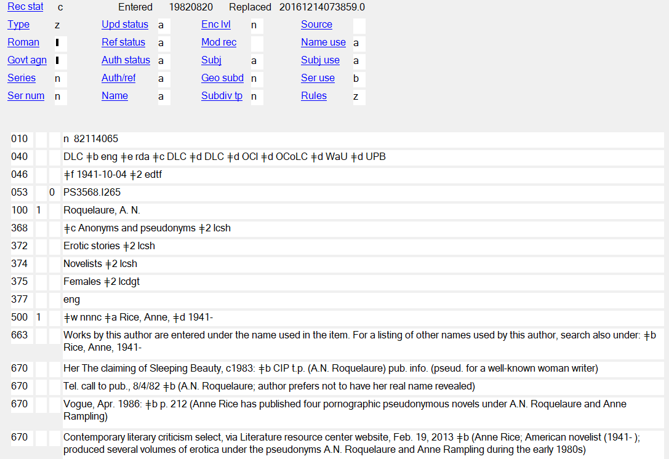
More than Two Identities (3)
Notes:
September 17, 2018

Slide 116
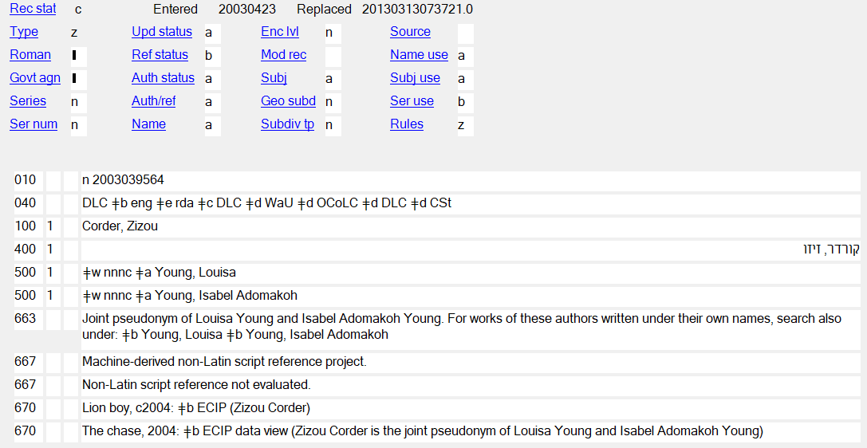
Shared Identity (1)
Notes:
September 17, 2018
The same “technique” is used when multiple persons use the same pseudonym. The 663 note on the Shared Identity NAR would read:
663 __ $a Joint pseudonym of <1st name> and <2nd name>. For works of these authors written under their own names, search also under: $b <1st name> $b <2nd name>

Slide 117
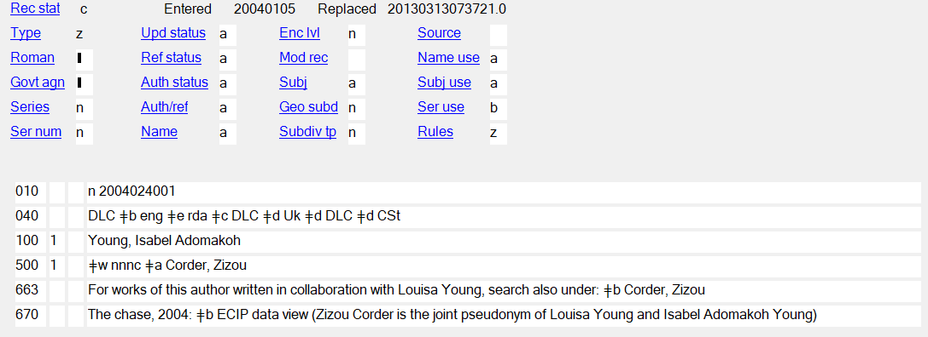
Shared Identity (2)
Notes:
September 17, 2018
And the 663 note on the individual NARs would be:
663 __ For works of this author written in collaboration with <name>, search also under: $b <joint identity access point>

Slide 118
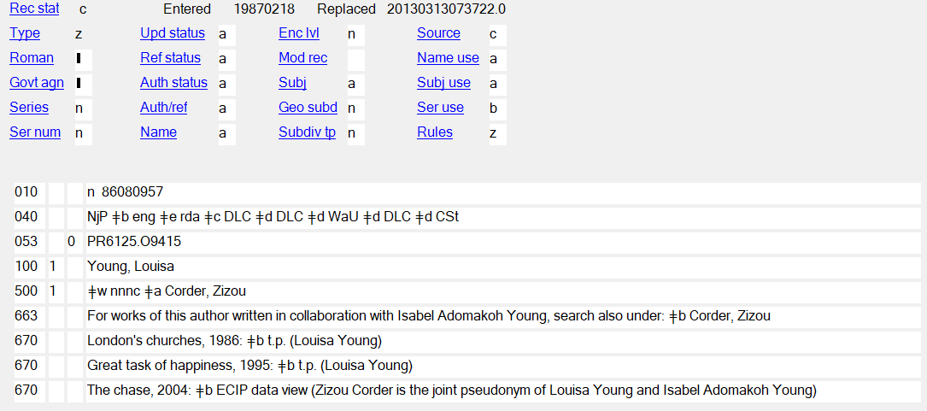
Shared Identity (3)
Notes:
September 17, 2018

Slide 119
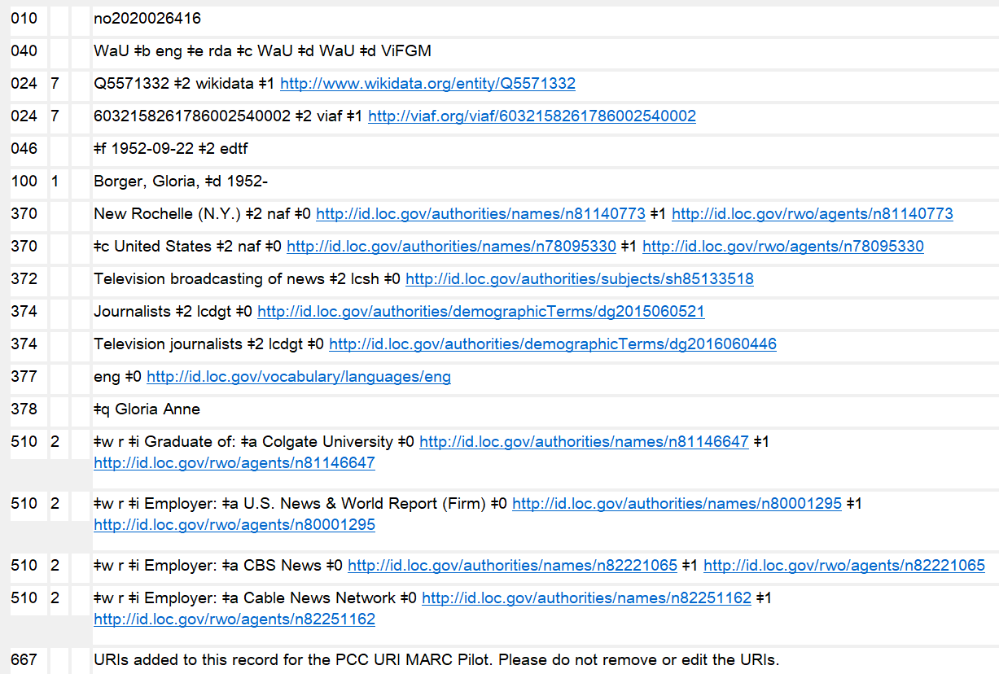
URIs in 3XX and 5XX
Notes:
July 30, 2025: updated speaker notes
October 3, 2024: updated screenshot from OCLC to delete 375 field; retained 667 field to show that this note may be found in existing records; updated instructor notes
August 16, 2023: updated notes to indicate that URIs may be added.
February 28, 2020: new slide showing URIs in 5XX
URIs may be added to 3XX and 5XX fields in accordance with PCC guidelines and best practices. Tools such as the Authority Toolkit (https://files.library.northwestern.edu/public/oclc/documentation/) may be used to automatically add URI subfields. Code authority record URIs in subfield $0, real world object URIs in $1, and relationship designator URIs in $4. The recommended order of subfields is $2 $4 $0 $1. When using RDA relationship URIs in $4, use unconstrained property URIs from the RDA Registry (https://www.rdaregistry.info/Elements/u/). Consult the URIs in MARC Pilot Resource Documents & Tools website (https://wiki.lyrasis.org/pages/viewpage.action?pageId=178881300). Note that PCC documentation on URIs is currently in the process of being revised and updated.
URIs were originally added as part of the PCC’s URIs in MARC Pilot project. The 667 note “URIs added to this record for the PCC URI MARC Pilot. Please do not remove or edit the URIs” is no longer required and may be deleted when a record is being revised for any reason.
Reminder: Any authorized access point given in a 5XX field must be established in its own authority record.
$0 - authority URI
$1 - real world object URI
$4 - relationship URI

Slide 120
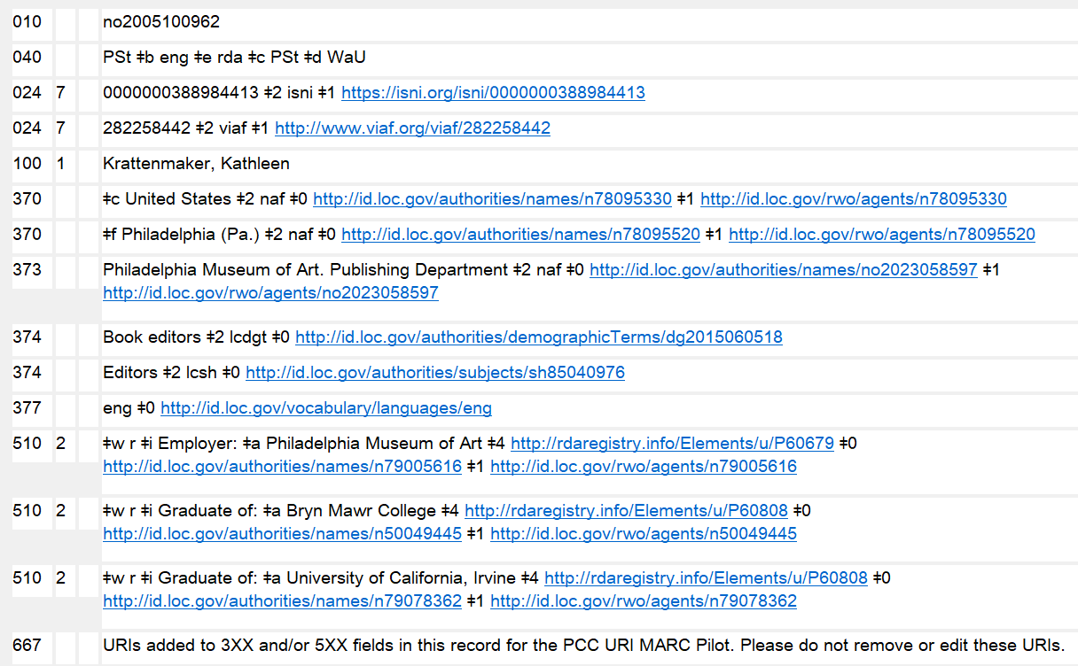
URIs in 3XX and 5XX
Notes:
July 30, 2025: replaced example in slide and updated speaker notes
October 3, 2024: updated screenshot from OCLC to delete 375 field; retained 667 field to show that this note may be found in existing records; updated instructor notes
August 16, 2023: updated notes to indicate that URIs may be added.
February 28, 2020: new slide showing URIs in 5XX
URIs may be added to 3XX and 5XX fields in accordance with PCC guidelines and best practices. Tools such as the Authority Toolkit (https://files.library.northwestern.edu/public/oclc/documentation/) may be used to automatically add URI subfields. Record authority record URIs in subfield $0, real world object URIs in $1, and relationship designator URIs in $4. The recommended order of subfields is $2 $4 $0 $1. When using RDA relationship URIs in $4, use unconstrained property URIs from the RDA Registry (https://www.rdaregistry.info/Elements/u/). Consult the URIs in MARC Pilot Resource Documents & Tools website (https://wiki.lyrasis.org/pages/viewpage.action?pageId=178881300), but note that PCC documentation on URIs is currently in the process of being revised and updated.
URIs were originally added as part of the PCC’s URIs in MARC Pilot project. The 667 note “URIs added to this record for the PCC URI MARC Pilot. Please do not remove or edit the URIs” is no longer required and may be deleted when a record is being revised for any reason.
Reminder: Any authorized access point given in a 5XX field must be established in its own authority record.
$0 - authority URI
$1 - real world object URI
$4 - relationship URI

Slide 121
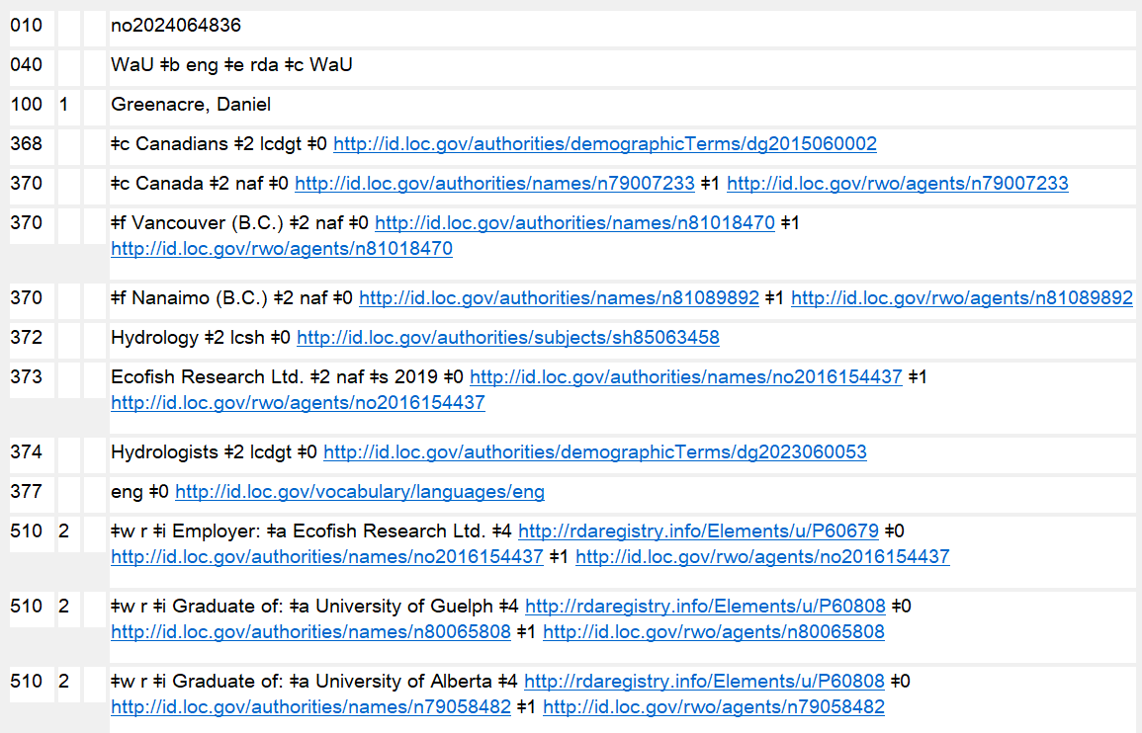
URIs in 3XX and 5XX
Notes:
July 30, 2025: updated speaker notes
October 3, 2024: updated screenshot from OCLC to delete 375 field; retained 667 field to show that this note may be found in existing records; updated instructor notes
August 16, 2023: updated notes to indicate that URIs may be added.
February 28, 2020: new slide showing URIs in 5XX
URIs may be added to 3XX and 5XX fields in accordance with PCC guidelines and best practices. Tools such as the Authority Toolkit (https://files.library.northwestern.edu/public/oclc/documentation/) may be used to automatically add URI subfields. Code authority record URIs in subfield $0, real world object URIs in $1, and relationship designator URIs in $4. The recommended order of subfields is $2 $4 $0 $1. When using RDA relationship URIs in $4, use unconstrained property URIs from the RDA Registry (https://www.rdaregistry.info/Elements/u/). Consult the URIs in MARC Pilot Resource Documents & Tools website (https://wiki.lyrasis.org/pages/viewpage.action?pageId=178881300). Note that PCC documentation on URIs is currently in the process of being revised and updated.
URIs were originally added as part of the PCC’s URIs in MARC Pilot project (2019-2021). During the pilot project a 667 note “URIs added to this record for the PCC URI MARC Pilot. Please do not remove or edit the URIs” was included in records. This note is no longer required and may be deleted when a record is being revised for any reason.
Reminder: Any authorized access point given in a 5XX field must be established in its own authority record.
$0 - authority URI
$1 - real world object URI
$4 - relationship URI

Slide 122
RDA authority record core and non-core
040 MARC organization code $b eng $e rda $c MARC organization code
046 $f 1914-03-31 $g 1998-04-19 $2 edtf
053 _0 PQ7297.P285
100 1_ Paz, Octavio, $d 1914-1998
400 1_ Paz Lozano, Octavio, $d 1914-1998
400 1_ Lozano, Octavio Paz, $d 1914-1998
400 1_ Paz, O. $q (Octavio), $d 1914-1998
368 $c Mexicans $c Nobel Prize winners $2 lcdgt
370 Mexico City (Mexico) $b Mexico City (Mexico) $c Mexico $e Spain $e United States $e India $e France $2 naf
372 Poetry $2 lcgft
372 International relations $2 lcsh
373 University of Cambridge $a University of Texas at Austin $a Harvard University $2 naf
374 Poets $a Diplomats $2 lcsh
377 spa
378 $q Paz Lozano
670 Piedra de sol, 1957: $b title page (Octavio Paz)
670 The collected poems of Octavio Paz, 1957-1987, 1991: $b page xiii (lived in Spain) page xiv (lived in United States) page xv (Mexican Ambassador to India in 1962; taught at Cambridge University, the University of Texas, and Harvard)
670 Actas del Primer Congreso Internacional sobre Luis Cernuda (1902-1963), 1990?: $b title page (O. Paz) page 13 (Octavio Paz)
670 Wikipedia, November 5, 2012 $b (Octavio Paz; Octavio Paz Lozano (March 31, 1914-April 19, 1998); Mexican writer, poet, and diplomat; winner of the 1990 Nobel Prize for Literature; lived in U.S., France, Spain, India, etc.)
Notes:
January 23, 2023: remove gender
November 15, 2019: added 053 field; added second term in 368; added 370 $c Mexico; added 372; corrected form for University of Texas in 373
Note that very little is core or required in an RDA record (in red). Institutions, including PCC (in blue), may declare additional elements to be required in the NARs their catalogers create. For example, the first source consulted (670) is core for PCC. (Language of cataloging is marked in the index as core but not in the rules themselves.)
Note on 370: The countries he lived in could have been coded in subfield $c or $e. There is currently no best practice guidance; either coding is correct.

Slide 123
Exercises 7 & 8
Using your worksheets, create descriptions of the two persons in the following slides
Create descriptions for other names associated with books you have brought
We can do some of these together in the LC/NACO Authority File
Notes:
May 1, 2013

Slide 124

Title page
This book was published
in 2012
Notes:
May 1, 2013
100 1_ Beauman, Ned
Teleportation accident, 2012 : $b t.p. (Ned Beauman)

Slide 125
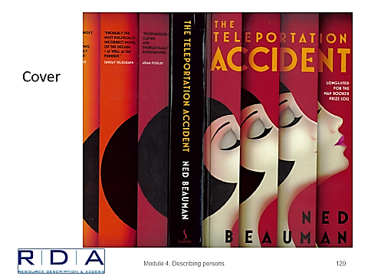
Notes:
May 1, 2013

Slide 126

Colophon
Notes:
May 1, 2013
Colophon of The Teleportation Accident:
Ned Beauman was born in 1985 and lives in London. His debut novel, Boxer, Beetle, won the Writers’ Guild Award for Best Fiction Book and the Goldberg Prize for Outstanding Debut Fiction, and was shortlisted for the Guardian First Book Award and the Desmond Elliot Prize. In 2011 he was chosen by The Culture Show as one of the twelve Best New British Writers.

Slide 127


This book was
published in 2011
Notes:
May 1, 2013
100 1_ Carter, William
670 Causes and Spirits, 2011 : $b t.p. (William Carter)

Slide 128
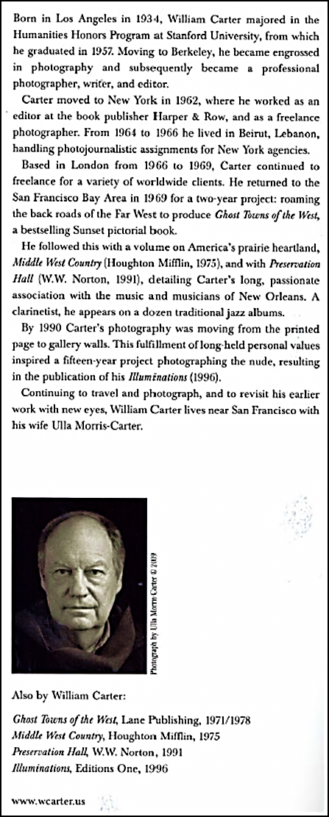

Notes:
May 1, 2013
Dust jacket for Causes and Spirits:
Born in Los Angeles in 1934, William Carter majored in the Humanities Honors Program at Stanford University, from which he graduated in 1957. Moving to Berkeley, he became engrossed in photography and subsequently became a professional photographer, writer, and editor.
Carter moved to New York in 1962, where he worked as an editor at the book publisher Harper & Row, and as a freelance photographer. From 1964 to 1966 he lived in Beirut, Lebanon, handling photojournalistic assignments for New York agencies.
Based in London from 1966 to 1969, Carter continued to freelance for a variety of worldwide clients. He returned to the San Francisco Bay Area in 1969 for a two-year project: roaming the back roads of the Far West to produce Ghost Towns of the West, a bestselling Sunset pictorial book.
He followed this with a volume on America’s prairie heartland, Middle West Country (Houghton Mifflin, 1975), and with Preservation Hall (W.W. Norton, 1991), detailing Carter’s long, passionate association with the music and musicians of New Orleans. A clarinetist, he appears on a dozen traditional jazz albums.
By 1990 Carter’s photography was moving from the printed page to gallery walls. This fulfillment of long-held personal values inspired a fifteen-year project photographing the nude, resulting in the publication of his Illuminations (1996).
Continuing to travel and photograph, and to revisit his earlier work with new eyes, William Carter lives near San Francisco with his wife Ulla Morris-Carter.

Slide 129
Personal Names: Things to Remember
  Start with the preferred name
Add dates if available
Make other additions as required or to break a conflict
Record variant access points when necessary or desirable
Record relationships as required (multiple identities) or desirable
Make sure authorized and variant access points, and other information recorded in various fields are justified in 670(s)
Record other attributes in special MARC fields as desired
Notes:
May 1, 2013

Slide 130
Module 2: Describing Persons
Questions?
Notes:
May 1, 2013

